Slide 1
INTRODUCTION
Nowadays Water Quality management has become a major problem of overall water resources management. The people who are living in rural areas will depend on low levels of water quality. That poor people don’t know what the chemicals contained in that low-level water. More pollutants will be generated if the populations and economics grow and finally they end up with the surface and groundwater bodies.

Slide 2
Every living thing or organism requires water not for just sufficient quantities but also contains quality to survive healthy. The main aim of this project is to identify the values, which are more affected by scanning the dataset and taking care to reduce contaminants in that rural area.
Drinking water quality can be determined by performing water quality analysis, which is a major component of the water distribution system.
Water quality analysis is considered as the most important component during drinking water quality analysis as it has a heavy impact on public health and industrial use.

Slide 3
The causes of water quality reduction are multi-folded and some of them include the following:
1. Poor sanitation.
2. Insufficient resources for monitoring and maintaining water quality management systems.
3. Salt water intrusion.
4. Chemical contamination.

Slide 4
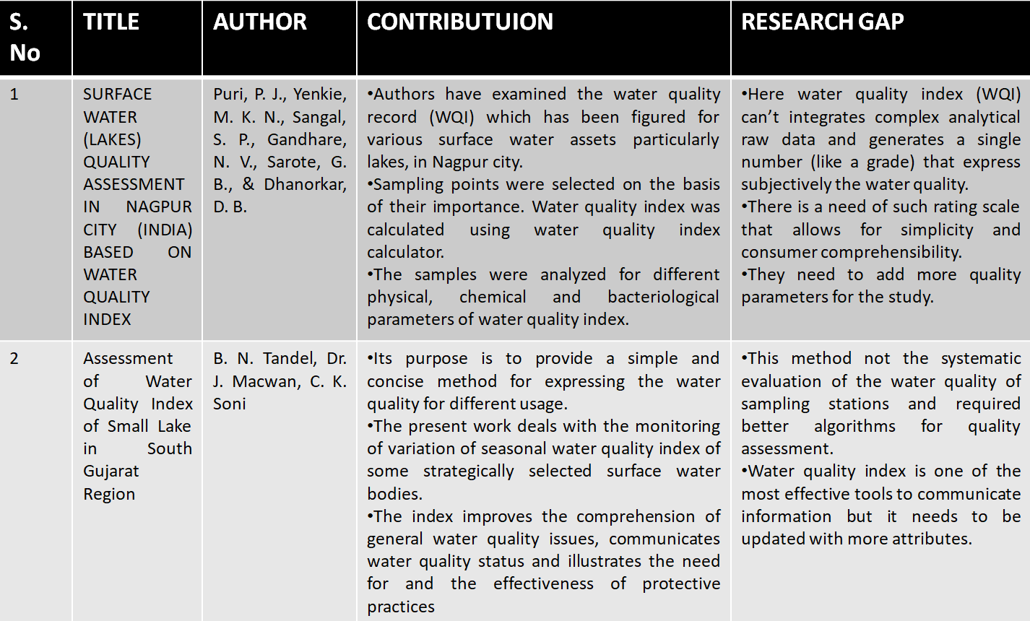
LITERATURE SURVEY

Slide 5
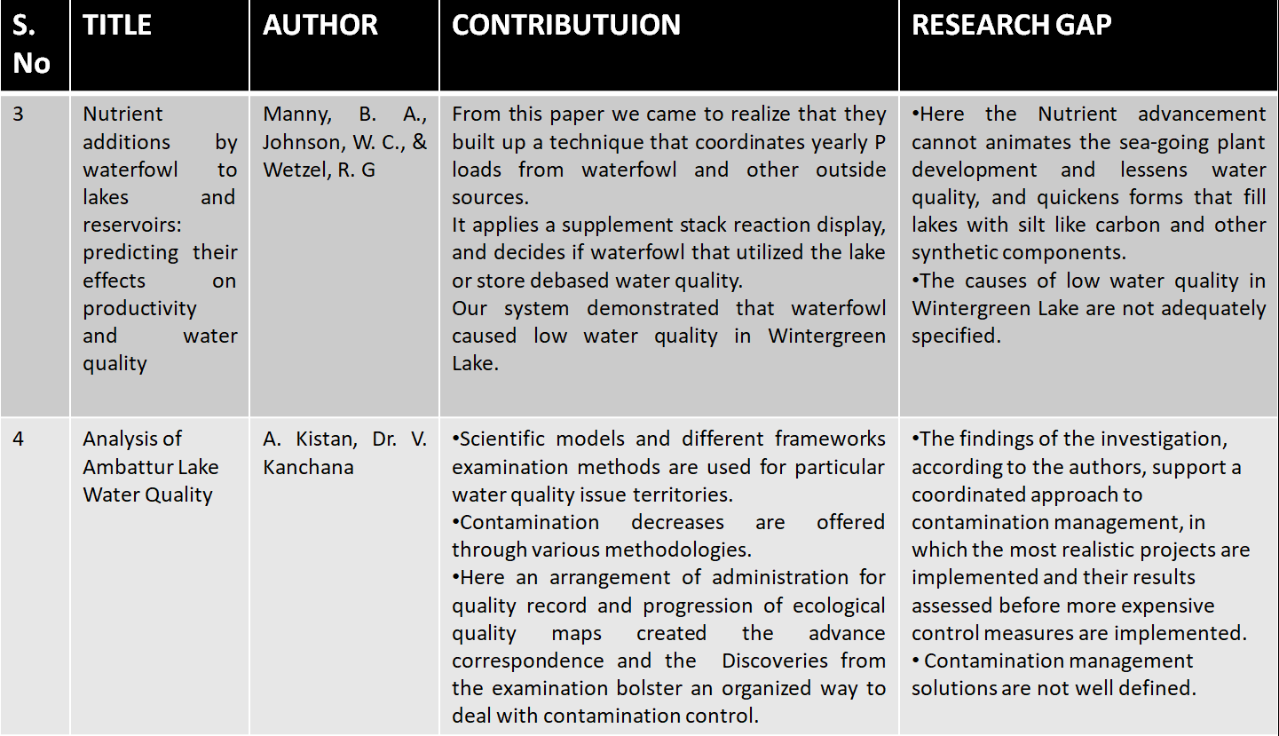

Slide 6
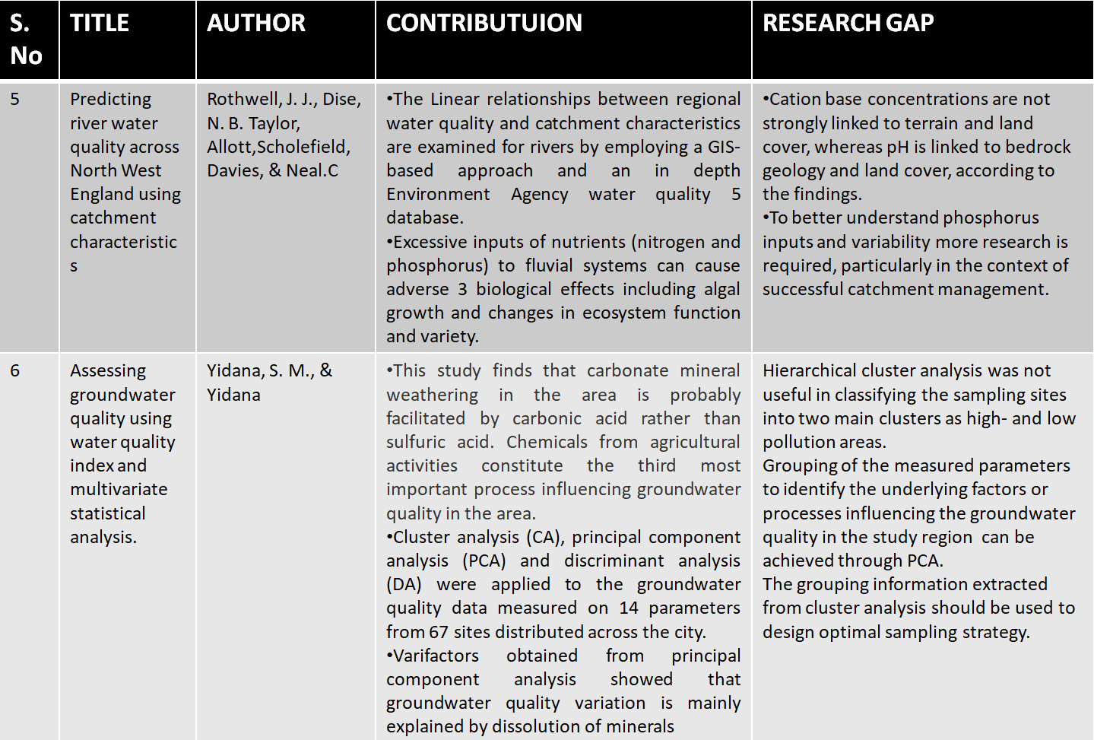

Slide 7
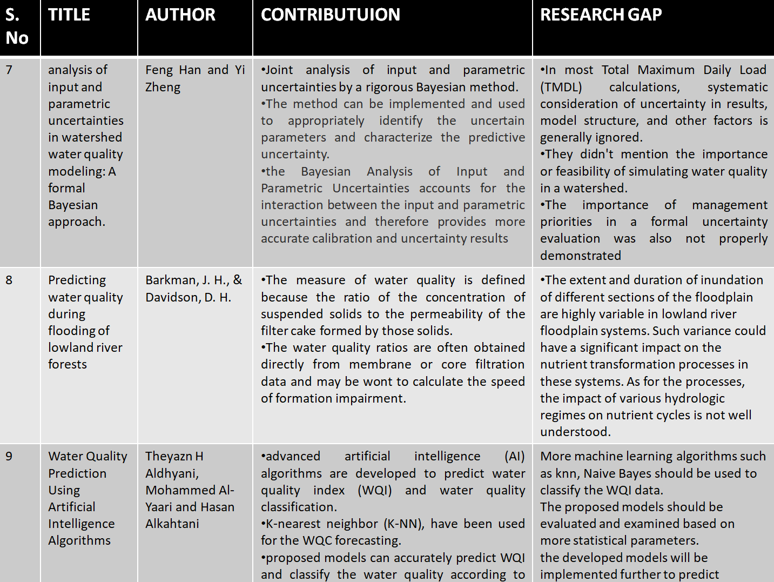

Slide 8
MODULES
Complaint Module
Data Processing Module
Data Acquisition
Data Pre Processing
Data Processing Parameters
Report Module
Analysis & Control Module

Slide 9
MODULE DESCRIPTION
Complaint Module:
In the complaint Module, the complaints are being handles and analyzed by officials once they get registered by the localities.
Here we are designing a portal in a way that we can interact with the people around us through this complaint module.
People can raise their respected queries or put any complaints with respect to quality of water or any problems related to their water and mention their panchayat details.
So the complaints are taken into consideration and actions are taken/provided by the officials accordingly.

Slide 10
Data Processing
Data Acquisition:
Data acquisition is often referred to as the process of digitalizing the data from the world around us so it can be displayed, analyzed and stored in a computer.
So in data acquisition we will collect data
When a citizen wants to raise a complaint that can be done through the web portal.
In the web portal we will be able to see the raised complaints by the people about the quality terms or any other regarding water issues.
This information (data) is then collected, analyzed and then stored in the computer.
During this process the ontology is used to navigate the user while collecting information using data type properties.

Slide 11
Data Preprocessing
Steps involved in data preprocessing are:
Data Cleaning: The data can have many irrelevant and missing parts. To handle this data cleaning is done. It involves handling missing data and noisy data.
Data Transformation: This step is done in order to transform the data in appropriate forms suitable for this project
Data Reduction: It increases the storage efficiency and reduces data storage and analysis costs.
Data Parameters:
Data has many parameters to consider, some data have to be filtered based on parameters such as Locality, State name, District name, Panchayat name, Village name, Quality parameters such as minerals and years. This data is processed based on the parameters

Slide 12
Report:
Reporting the final results obtained from metric analysis and other graphs generated. This includes defining the report format, data extraction and reporting cycle, reporting mechanisms, distribution, and availability. The reporting cycle defines how often the report is generated and when it is due for distribution.
A software development project is an experiment that is based on a number of assumptions, theories and estimates. To confirm these measurements are taken for all significant processes and then analyzed. The results of the analysis are used to make decisions.

Slide 13
Analysis and Control:
Analysis and Control manages and controls the overall assessing and predicting water quality process. This module identifies the work to be performed and develops the schedules and cost estimates for the work efforts.
Risk identification studies are conducted to aid in risk management. Analysis also identify critical parameters and paths to be used in progress measurement. It specifies the parameters to be measured for progress measurement. It conducts evaluation and reports progress.

Slide 14
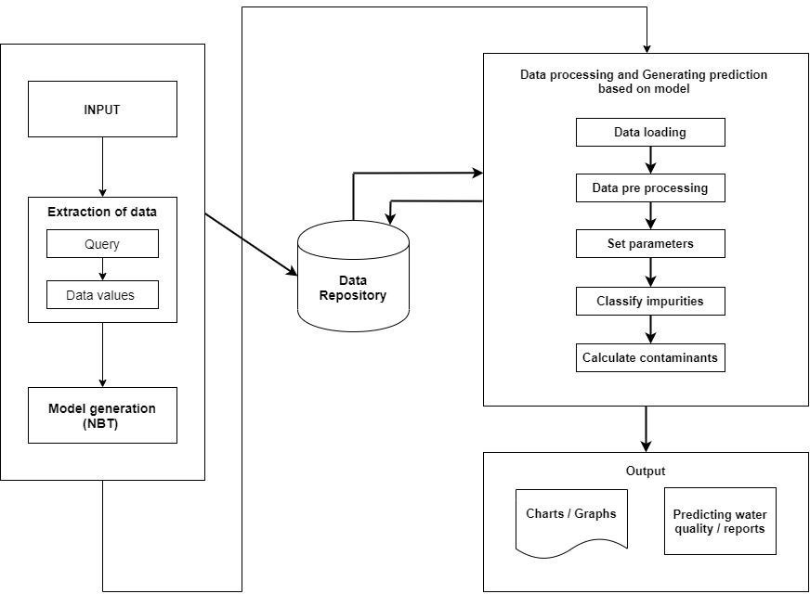
SYSTEM ARCHITECTURE

Slide 15
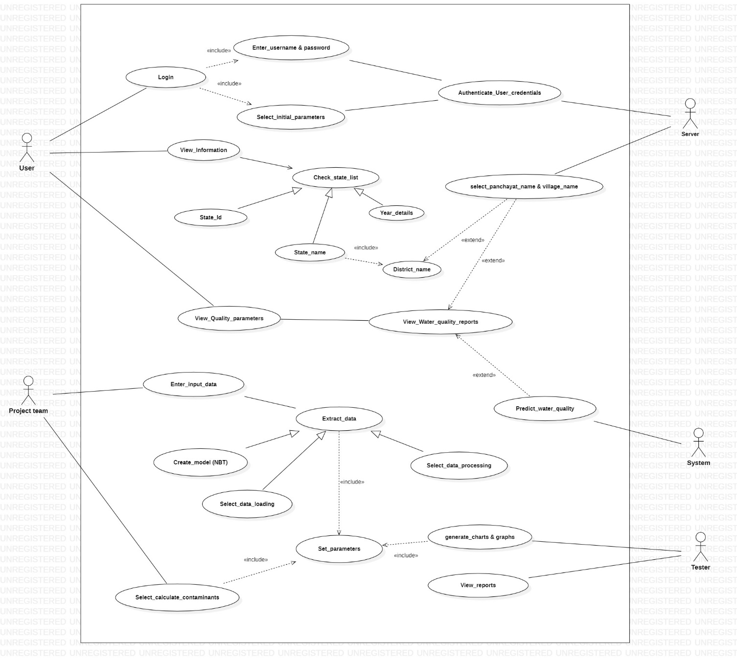
USE CASE DIAGRAM

Slide 16
PROJECT RESOURCE REQUIREMENTS
Software Requirements:
Python
Tools:
Weka
Anaconda
XAMP Server
Hardware Requirements:
Laptop
Windows OS
Internet Connectivity

Slide 17
Weka
Weka contains a collection of visualization tools and algorithms for data analysis and predictive modeling, together with graphical user interfaces for easy access to these functions.
Advantages of Weka include:
Free availability under the GNU General Public License.
Portability, since it is fully implemented in the Java programming language and thus runs on almost any modern computing platform.
A comprehensive collection of data preprocessing and modeling techniques. Ease of use due to its graphical user interfaces.
Weka supports several standard data mining tasks, more specifically, data preprocessing, clustering, classification, regression, visualization, and feature selection. All of Weka's techniques are predicated on the assumption that the data is available as one flat file or relation, where each data point is described by a fixed number of attributes

Slide 18
Anaconda
Anaconda is a FREE enterprise-ready Python distribution for data analytics, processing, and scientific computing. Anaconda comes with Python 2.7 or Python 3.4 and 100+ cross-platform tested and optimized Python packages. All of the usual Python ecosystem tools work with Anaconda.
Anaconda Advantages
Depends on your preference though, but I prefer Anaconda because it gives the User ability to make an easy install of the version of python they want.
You might not have an idea of how much a problem admin privileges can be if you are using your laptop and not a company owned. but Anaconda removes all those problems.
It gives high performance computing with Anaconda Accelerate and several other components.
Removes bottlenecks involved in installing the right packages while taking into considerations their compatibility with various other packages as might be encountered while using pip. There is no risk of messing up required system libraries.

Slide 19
XAMP Server
XAMPP is a free and open-source cross-platform web server solution stack package developed by Apache, consisting mainly of the Apache HTTP Server, MariaDB database, and interpreters for scripts written in the PHP and Perl programming languages. Since most actual web server deployments use the same components as XAMPP, it makes transitioning from a local test server to a live server possible.
Advantages of XAMPP
It is free and easy to use and easily available for Windows, Linux and Mac OS .
It is a beginners friendly solution package for full stack web development.
It is a open source software package which gives a easy installation experience.
It is very simple and lightweight to create set up for development, testing and deployment.
It is a time-saver and provides several ways for managing configuration changes.

Slide 20
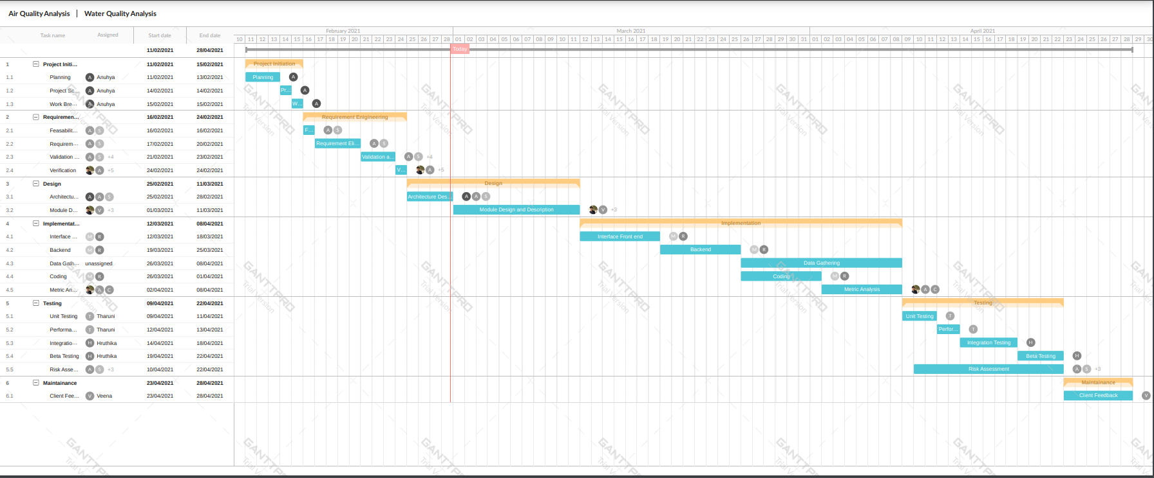
GANTT CHART

Slide 21
Metrics Used:
Team Member | Metrics
B Anuhya | Productivity Planned to done ration GQM Size Oriented Metrics Project Metrics Cycle Time
R Veena | Requirement Stability Index Function Point Schedule Metrics [Bar Graph] Schedule Variance Review Efficiency Percentage of team meetings achieved vs planned Effort Variance

Slide 22
Team Member | Metrics
C Ashok | Size Oriented Metrics Project Metrics Team Collaboration Metrics Sprint Effort Measurement Productivity Metrics Requirements Stability Index Use-case Point Analysis
V Surya Kamal | Lines Of Code Halstead’s Metrics McCabe’s Cyclomatic Complexity Maintainability Index Programmer Productivity

Slide 23
Team Member | Metrics
P Chandana Shreya | Lines Of Code Halstead’s Metrics McCabe’s Cyclomatic Complexity Code Churn Metrics (at the beginning) Code Churn Metrics (at the end)
T Tharuni | Code coverage Code error density Defect escape ratio Defect density Defect density per KLOC Defect removal efficiency Test Metrics
K Sarayu | Use Case Point Object Point Plan to Done ratio Programmer productivity according to module

Slide 24
Team Member | Metrics
Rohin Hodkasia | Token Metrics LOC Metrics CCN Metrics (Cyclomatic Complexity Number) Repeatable Metrics Size Metrics Productivity Metrics
B Hruthika | Lines Of Code Productivity Metrics Team Velocity Cyclomatic Complexity
T Manisha | Testing Metrics Code Coverage Code Coverage percentage Test Execution coverage Defect Density

Slide 25
PROJECT MANAGER: B ANUHYA
Supervisor
Dr. Nancy Victor
Assistant Professor, SITE
B Anuhya
18MIS0394

Slide 26



Project Manager: Work
Work division and assignment
Preparing GQM
Providing assistance
Keeping a track on productivity by calculating total effort to budgeted effort
Tracking change requests to keep the project on time
Conducting the meetings to discuss future plans and progress.
Making sure the errors are reduced over time
Ensuring that everyone in team gets proper resources
Prepared schedule of deadlines and activities
Evaluate various productivity and quality metrics
Coordinated the team by overcoming miscommunication.
Assessed the performance of each team member.
Conducted some cost metrics.
Ensuring customer satisfaction

Slide 27
Metrics Used:
Productivity
Planned to done ration
GQM
Size Oriented Metrics
Project Metrics
Cycle Time

Slide 28
Metrics:
Productivity
Planned to done ratio
Effort of Team members
GQM: Stands for Goal, Question, metric, GQM approach is a proven method for driving goal-oriented measures throughout a software organization. With GQM, we start by defining the goals we are trying to achieve, then clarifying the questions we are trying to answer with the data we collect.
Size Oriented Metrics: They are derived by normalizing Quality and/or Productivity Measures by considering the Size of Software that has been produced.
Project Metrics: They are collected across all Projects and over long periods of time and their intent is to provide a set of Process Indicators.
Cycle time: Cycle time is the duration of a process from start to end. This can be used as a metric to manage processes. Alternatively, it can be used to plan and improve orientations such as productivity. Based on the gantt chart the starting and end date can be calculated

Slide 29
Productivity
These metrics can be used to track and measure how efficient our team is in getting the tasks done. These metrics are used to manage and improve performance of our project as well as highlight where we need to improve.
a) Planned-to-done ratio: The planned-to-done ratio calculates what
percentage of the assigned tasks were completed adequately. It also helps in
tracking whether the project is getting done in the way we planned them.

Slide 30
Month- March
Month-March | Planned Activities | Done Activities | Planned to done Ratio
Team -1 | 1.Literature Survey (4 papers) 2.Module’s description and analysis 3.Requirements gathering and elicitation 4. Brainstorming | 1.Literature Survey (4 papers) 2.Module’s description and analysis 3.Requirements gathering and elicitation | 4:3
Team -2 | 1.Literature Survey (4 papers) 2. Usecase Diagram 3. Requirements gathering and analysis 4. Architecture Diagram 5. Gantt chart | 1.Literature Survey (4 papers) 2. Usecase Diagram 3. Requirements gathering and analysis 4. Architecture Diagram | 5:4
Testers | 1.Literature Survey (2 papers) 2. Analysis on Literature Survey 3. Testing the compatibility between module description and the requirements gathered | 1. Literature Survey (2 papers) 2. Analysis on Literature Survey 3. Testing the compatibility between module description and the requirements gathered | 3:3

Slide 31
Month- April
Month-April | Planned Activities | Done Activities | Planned to done Ratio
Team -1 | 1. Development of Data Processing module 2. Development of submodules like data acquisition, preprocessing, transformation and reduction modules. 3. Algorithm analysis 4.Gather software metrics for developers | 1. Development of Data Processing module 2. Development of submodules like data acquisition, preprocessing, transformation and reduction modules. 3. Algorithm analysis 4.Find metrics for developers | 4:4
Team -2 | 1. Development of web portal to monitor and manage complaints from stakeholders 2. Collecting dataset and coordinating with team-1 3. Algorithm analysis 4. Finding metrics for managers 5.Gather software metrics for testers | Development of web portal to monitor and manage complaints from stakeholders 2. Algorithm analysis 3. Finding metrics for managers 4..Gather software metrics for testers | 5:4
Testers | 1.Find errors in developed modules 2. Report errors 3. Gather software metrics for testers 4. Shortlisting the metrics suitable for this project. | 1.Find errors in developed modules 2. Report errors | 4:2

Slide 32
Month- May
Month-April | Planned Activities | Done Activities | Planned to done Ratio
Team -1 | 1. Development of report , analysis and control modules. 2. Evaluate Metrics of Manager 3. Calculate Halstead Metrics for the project 4. Release surveys to know about customer satisfaction 5.. Documentation | 1. Development of report, analysis and control modules. 2. Evaluated Metrics of Manager 3. Calculated Halstead Metrics for the project | 5:3
Team -2 | 1. Make final changes to the web portal and run it on localhost` 2.Calculate performance testing of the website 3.Release surveys to know about customer satisfaction 4. Documentation | 1. Development of edge detection module. 2. Calculate performance testing of the website 3. Release surveys to know about customer satisfaction. 4.Documentation | 4:4
Testers | 1. Gather software metrics for testers 2. Evaluate Metrics of developers 3. Test the Source code. | 1. Gather software metrics for testers 2. Test the Source code. | 3:2

Slide 33

b) Effort of Team members: This metrics helps us to assess the effort of each team member. This will help us to determine the overall productivity of the project and team members.

Slide 34
Team Members | Number of Activities assigned | Number of Activities Performed | Number of weeks worked
Anuhya Balija (Project manager) | 10 | 10 | 8 weeks
Veena (Senior Analyst) | 8 | 8 | 8 weeks
Ashok (Team Manager) | 10 | 10 | 8 weeks
Sarayu (Team Manager) | 10 | 10 | 8 weeks
Surya (Developer) | 7 | 7 | 8 weeks
Chandana Sreya (Developer) | 7 | 7 | 8 weeks
Rohin (Developer ) | 6 | 6 | 8 weeks
Hruthika (Developer) | 6 | 6 | 8 weeks
Manisha(Tester) | 5 | 5 | 6 weeks
Tharuni (Tester) | 5 | 5 | 6 weeks

Slide 35
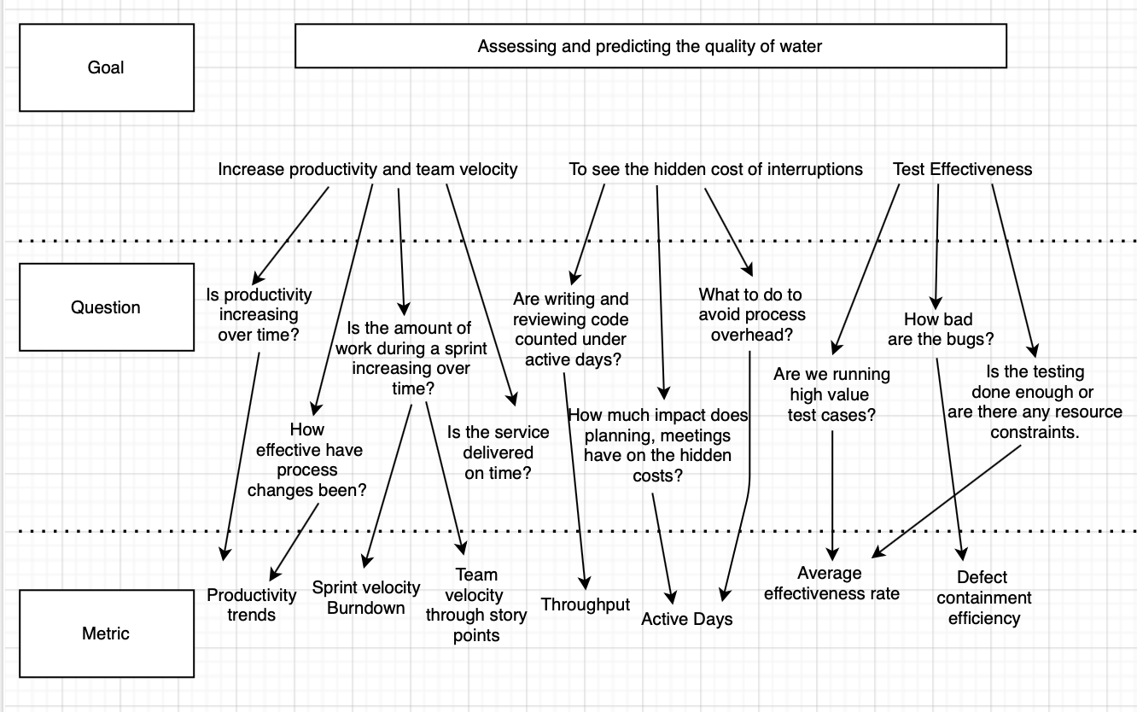
Goal Quality Metrics

Slide 36
Cycle Time
Cycle time is the duration of a process from start to end. This can be used as a metric to manage processes. Alternatively, it can be used to plan and improve orientations such as productivity. Based on the Gantt chart the starting and end date can be calculated
Activity | Start Date | End date
Planning | 11/02/2021 | 13/02/2021
Project Scope | 14/02/2021 | 14/02/2021
Work distribution | 15/02/2021 | 15/02/2021
Feasibility study | 22/02/2021 | 23/02/2021
Requirements Elicitation | 24/02/2021 | 26/02/2021
System Architecture | 28/02/2021 | 01/03/2021
Module Design and Description | 01/03/2021 | 11/03/2021
Interface Front end | 12/03/2021 | 18/03/2021
Backend | 22/03/2021 | 28/03/2021
Data Acquisition | 29/03/2021 | 31/03/2021
Coding | 01/04/2021 | 20/04/2021
Metrics identification | 22/04/2021 | 25/04/2021
Metrics Analysis | 27/04/2021 | 14/05/2021
Performance Testing | 16/05/2021 | 17/05/2021
Documentation | 19/05/2021 | 02/06/2021

Slide 37
Cycle Time
Cycle time=End Date-Start Date
For same day task completion
Cycle time=End Date -Start Date +1
Activity | Start Date | End date | Cycle Time
Planning | 11/02/2021 | 13/02/2021 | 2 days
Project Scope | 14/02/2021 | 14/02/2021 | 1 day
Work distribution | 15/02/2021 | 15/02/2021 | 1 day
Feasibility study | 22/02/2021 | 23/02/2021 | 1 day
Requirements Elicitation | 24/02/2021 | 26/02/2021 | 2 days
System Architecture | 28/02/2021 | 01/03/2021 | 1 day
Module Design and Description | 01/03/2021 | 11/03/2021 | 10 days
Interface Front end | 12/03/2021 | 18/03/2021 | 6 days
Backend | 22/03/2021 | 28/03/2021 | 6 days
Data Acquisition | 29/03/2021 | 31/03/2021 | 2 days
Coding | 01/04/2021 | 20/04/2021 | 19 days
Metrics identification | 22/04/2021 | 25/04/2021 | 3 days
Metrics Analysis | 27/04/2021 | 14/05/2021 | 17 days
Performance Testing | 16/05/2021 | 17/05/2021 | 1day
Documentation | 19/05/2021 | 02/06/2021 | 14 days

Slide 38
Programmer Productivity
Programmer Productivity is the degree of the ability of an individual programmer to build and evolve software systems.
Team -1 : Programmer Productivity( Surya)
= LOC Produced / Person Months of Effort
= 323/ 2 = 161.5
Team -1: Programmer Productivity (Chandana)
= LOC Produced / Person Months of Effort
=171/2 =85.5
Team -2 : Programmer Productivity (Rohin)
= LOC Produced / Person Months of Effort
=227289/2.5=90915
Team -2: Programmer Productivity (Hruthika)
= LOC Produced / Person Months of Effort
=8644/2=4322

Slide 39
SENIOR ANALYST: R VEENA
Supervisor
Dr. Nancy Victor
Assistant Professor, SITE
R Veena
18MIS0025

Slide 40
Senior Analyst: Work
Requirements elicitation.
Keeping track on how much data is tested.
‌Checking if the project is being built in accordance with the specifications mentioned.
Conducting meetings with the team members to know the work progress.
‌Updating work progress to the project manager and stakeholders.
‌Getting updates from the project manager and convey them to team managers.
Facilitating the teams.

Slide 41
Functional Requirements Complaint Module: a) User:
FR-1 | The system should allows the user to register themselves.
FR-2 | Users can able to enter the information like username, email id, phone number, password etc to create an account in the system.
FR-3 | System should able to valid and insert the details in the database when the user creates new account.
FR-4 | The system should allow the user to login to the system.
FR-5 | Users can able to enter username and password.
FR-6 | System should verify the details of the user with the database and make the user to enter into their account.
FR-7 | System should allow the user to change their profile.
FR-8 | User can able to change their profile picture, username and password in the profile webpage.

Slide 42
FR-9 | When user request to change their profile, system database should also be updated.
FR-10 | A Dashboard should be appeared after the user logged into the system.
FR-11 | The dashboard should contain total, approved, fixed, pending complaints of a respective user.
FR-12 | User can add complaints.
FR-13 | In complaint form user has to fill complaint reason and address of their particular area.
FR-14 | After submitting the form the complaint has to be updated in database and reflect in the admin’s dashboard.
FR-15 | The system should allow the users to logout from the system in any moment.
FR-16 | In every page there must be menu section to navigate and logout.
FR-17 | Menu section should allow the user to logout from the system.
FR-18 | The system should take the user to home page after log out.

Slide 43
b) Admin:
FR-19 | The system should allow the Admin to login to the system.
FR-20 | Admin can able to enter username and password.
FR-21 | System should verify the details of the admin with the database and make the admin to enter into his account.
FR-22 | A Dashboard should be appeared after admin logged into the system.
FR-23 | The dashboard should contain total, approved, fixed, pending complaints of all the users.
FR-24 | System should allow the admin to change their profile.
FR-25 | Admin can able to change their profile picture, name and password in the profile webpage.
FR-26 | When admin request to change his profile, system database should also be updated.

Slide 44
FR-27 | Admin should able to view the users in users page.
FR-28 | Admin can add departments.
FR-29 | In departments page admin should able to add departments with their ID numbers and name.
FR-30 | When the admin adds new department, the database should be updated.
FR-31 | Admin should able to view the complaints reported by the users in complaints page.
FR-32 | Admin can take action on users complaint weather to approve or decline.
FR-33 | The action taken by the admin should be updated in database and reflect on respective user side.
FR-34 | The system should allow admin to logout from the system in any moment.
FR-35 | In every page there must be menu section to navigate and logout.
FR-36 | Menu section should allow the admin to logout from the system.
FR-37 | The system should take the admin to home page after log out.

Slide 45
Data Processing:
Data Processing Parameters:
FR-38 | Preprocess the dataset collected.
FR-39 | Select the dataset based on predicting quality of water.
FR-40 | Download the dataset which has been choosed.
FR-41 | Check weather all the parameters has values.
FR-42 | If any value is missed it should be updated by mean of the parameter.
FR-43 | Preprocess the dataset parameters.
FR-44 | Dataset has many parameters to consider, some parameters should be filtered based on parameters such as locality, state name, district name, village name, quality parameters such as minerals and year.
FR-45 | Dataset should be updated accordingly.

Slide 46
Report:
Non-Functional Requirements:
Security:
FR-46 | Make analysis on dataset.
FR-47 | For analysis construct navie bayes classifier.
FR-48 | Dataset should be passed through the classifier.
FR-49 | Classifier should classify the dataset into training and testing dataset.
FR-50 | It should provide the graphs based on water quality on each state in the dataset.
NFR-1 | Login requirements-access levels.
NFR-2 | Password requirements-length, special characters, numbers
NFR-3 | Inactivity timeouts-durations, actions

Slide 47
Capacity:
Performance:
NFR-4 | Throughput- how many times can a person can login to the system
NFR-5 | Storage- how much data does the system need to be able to store.
NFR-6 | Year-on-year growth requirements
NFR-7 | Webportal should be capable of handling multiple users at a time.
NFR-8 | If the internet connectivity is low, the data should be stored in draft.
NFR-9 | The response time of the system should be instantaneous.
NFR-10 | The system should not store the information without user acceptance.

Slide 48
Metrics Used:
Requirement Stability Index
Function Point
Schedule Metrics [Bar Graph]
Schedule Variance
Review Efficiency
Percentage of team meetings achieved vs planned
Effort Variance

Slide 49
Requirements stability Index
Metrics:
RSI is used to measure the changes in the project requirements added or deleted compared to the orginal requirements decided at the starting of the project.
At the starting stage of project we taught of preparing a portal for complaint module with user side where they can apply complaint and admin side where he can view the complaints. But while developing we added some more requirements like admin side where he can accept or reject the complaints of the users and it also reflects on user side.
RSI=(Number of orginal requirements + Number of changed+ Number of deleted+ Number of added)/Total number of orginal requirements
RSI=(0+4+0)/56=0.074
No.of intial requirements | No. of Changed | No. of Added | No. of Deleted | Requirement Stability Index
56 | 0 | 4 | 0 | 0.074

Slide 50
Function Types and the Weighting Factors:
Function Type | Simple | Average | Complex
Internal Logical File | 7 | 10 | 15
External Interface File | 5 | 7 | 10
External Input | 3 | 4 | 6
External Output | 4 | 5 | 7
External Inquiry | 3 | 4 | 6

Slide 51
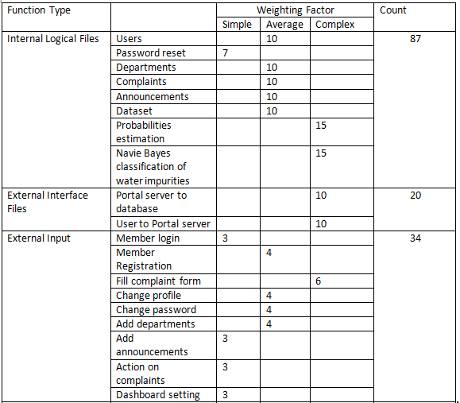
Function Point

Slide 52
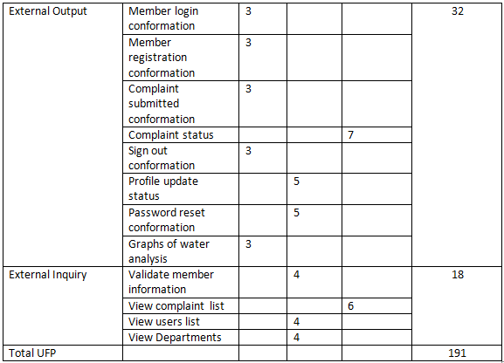

Slide 53
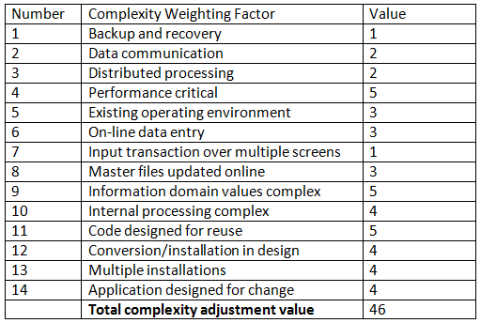
Adjustment Function Point
Total Unadjusted Function Points (UFP)=191
Product Complexity Adjustment(PC)= 0.65+(0.01*46)=1.11
Total Adjustment Function Points (FP)=
UFP*FP= 212.01

Slide 54
Schedule Metrics

Slide 55
Schedule Variance:
Any difference between the schedule completion of an activity and the actual completion is known as Schedule Variance.
Schedule Variance=(((Actual calendar days-Planned calendar days)+ Start variance)/ Planned calendar days)*100=((98-74)+1)/74)*100=33.78
Review Efficiency:
It is defined as the efficiency in harnessing/ detecting review defects in the verification stage.
Review Efficiency=(number of defects caught in review)/total number of defects cause=2/11=0.18

Slide 56
Percentage of team meeting achieved vs planned:
(Number of meetings conducted/Number of meetings planned)*100=(4/5)*100=80%
Effort Variance:
Difference between the planned outlined effort and the effort required to actually undertake the project is called Effort variance.
Effort Variance=(Actual Effort-Planned Effort)/Planned Effort*100=((83-80)/80)*100=3.75

Slide 57
TEAM MANAGER: CH ASHOK
Supervisor
Dr. Nancy Victor
Assistant Professor, SITE
Ch.Ashok
18MIS0034

Slide 58
Team 1 Manager: Work
Ensure team understands the objectives and work together to achieve it.
Supervise the project team members and guide them.
Splitting and assigning of the work to each individual team member.
Evaluate the Project Team’s ability to Control Quality of Software Work Product.
Updating the work progress to the Project manager.
Sets targets, implement guidelines, and assist with any issues.
Get updates from the project manager and convey to team.
Keep the team on scheduled time and scheduling
team meetings on regular basis and communicate with them.
Assess the status of an ongoing Project and make reports.

Slide 59
Metrics
Size Oriented Metrics: They are derived by normalizing Quality and/or Productivity Measures by considering the Size of Software that has been produced.
Project Metrics: They are collected across all Projects and over long periods of time and their intent is to provide a set of Process Indicators.
Team Collaboration Metrics: How a team is behaving in the code review process.
Burn down chart : (Sprint Effort Measurement )
Productivity metrics: Helps to track and measure how efficient my team is in getting their tasks done.
Key Performance Indicators Metrics (KPI’s): key indicators of individual’s performance.
Objectives and Key Results Metrics (OKR’s): Demonstrate how the team is meeting its objectives.

Slide 60
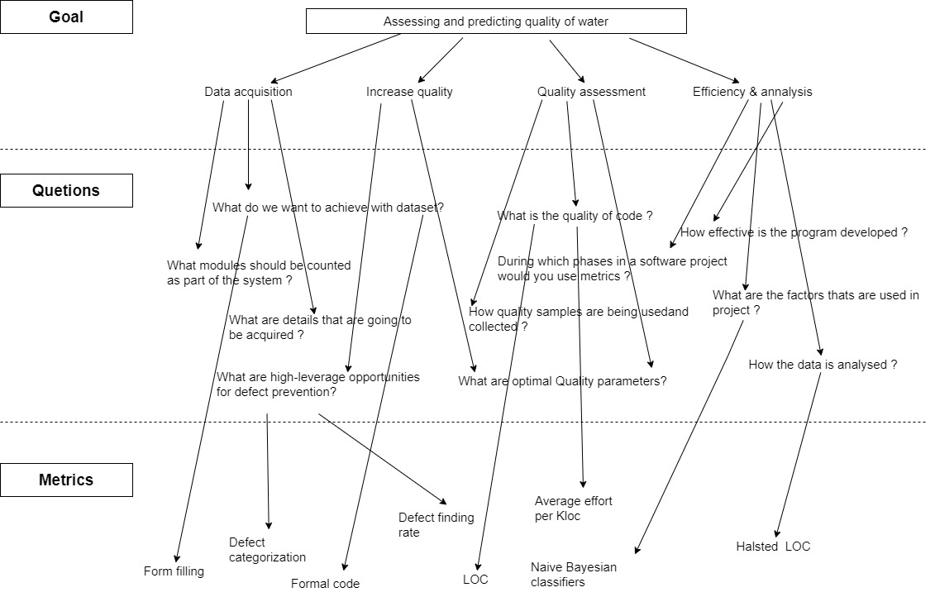
GQM: PROJECT A

Slide 61
Size-Oriented Metrics:
The Table below lists each Software Development Project that has been completed by the software developers and corresponding Measures for that Project.
Referring to Project (A): P. Chandana Sreya-18MIS0041
171 Lines of Code (LOC) were developed within 2 Person- Months of Effort at a cost of $0.
The Effort and Cost recorded in the table represents all Software Engineering Activities i.e. Analysis, Design, Code, and Test)
Project A also indicates that 11 Pages of Documentation were developed.
14 Errors were recorded before the Software released.
3 Defects were encountered after the work finish within the first development cycle operation.
1 Software Developer worked on Project (A) development.

Slide 62
Size-Oriented Metrics:
Referring to Project (B): V. Surya Kamal-18MIS0090
323 Lines of Code (LOC) were developed within 24 Person- Months of Effort at a cost of $0.
Project A also indicates that 13 Pages of Documentation were developed.
21 Errors were recorded before the Software released.
4 Defects were encountered after the work finish within the first development cycle operation.
1 Software Developer worked on Project (A) development.
PROJECT | LOC | EFFORT | PP. Doc | Errors | Defects | People
A | 171 | 2 | 11 | 14 | 3 | 1
B | 323 | 2 | 13 | 21 | 4 | 1

Slide 63
Size-Oriented Metrics:
The estimated human effort by work package can be calculated as follows (indicative method):
If 1 year = 220 (working) days
Then 1 month = 220/12 = 18.33 (working) days.
So 20 full working days for one person would be 20/18.33 = 1.09 person-months.
Here we have two developers with the percentage of their effort being 50% each in developing the project and they worked for 4 months in the total academic year of the project.
(50% x 4) = 2.0 person-months for each developer.

Slide 64
Size-Oriented Metrics:
We can calculate the following Size Oriented Metrics:
For Project Developer A:
Page of Document / KLOC (11 / 2.1 = 64.33)
Errors / Person-Month (14 / 2 = 7 )
LOC / Person-Month ( 171 / 2 = 85.5)
For Project Developer B:
Page of Document / KLOC (13 / 2.1 = 40.24)
Errors / Person-Month (21 / 2 = 10.5 )
LOC / Person-Month ( 323 / 2 = 161.5)
KLOC: Thousand of Lines of Code A: (171 LOC = 0.171 KLOC)
KLOC: Thousand of Lines of Code B: (323 LOC = 0.323 KLOC)

Slide 65
Project Metrics:
Effort Variance Metric: Difference between the planned outlined effort and the effort required to actually undertake the task is called Effort variance.
Effort variance = (Actual Effort – Planned Effort)/ Planned Effort x 100.
Actual Effort (in hrs) = 74
Planned Effort (in hrs) = 77
Effort Variance = ( (74 – 77) / 77 ) x 100 = -3.9%
Effort Variance should not exceed ± 5%.
Schedule Variance Metric: Any difference between the scheduled completion of an activity and the actual completion is known as Schedule Variance.
Schedule variance = ((Actual Duration – Planned Duration) x 100 / Planned Duration
Actual Duration (in Days): Actual end date - Planned start date = (82-1)=81
Planned Duration (in Days): Planned end date - Planned start date = (77-1)=76
Schedule variance = ((81-76) x 100 ) / 76 = 6.58 %

Slide 66
Project Metrics:
Requirement Stability Index: Provides visibility to the magnitude and impact of requirements changes.
RSI = (Original Requirements + Number of changed + Number of deleted + Number of added) / ( Total number of Original requirements)
Total number of Original Requirements = 50
Cumulative number of requirements changed (till date) = 1
Cumulative number of requirements added (till date) = 2
Cumulative number of requirements deleted (till date) = 1
RSI = (22+1+2+1)/22 = 1.18
This can be factored into plan and rework effort and schedule for remaining phases/activities/modules and this helps to know how stable the requirements.

Slide 67
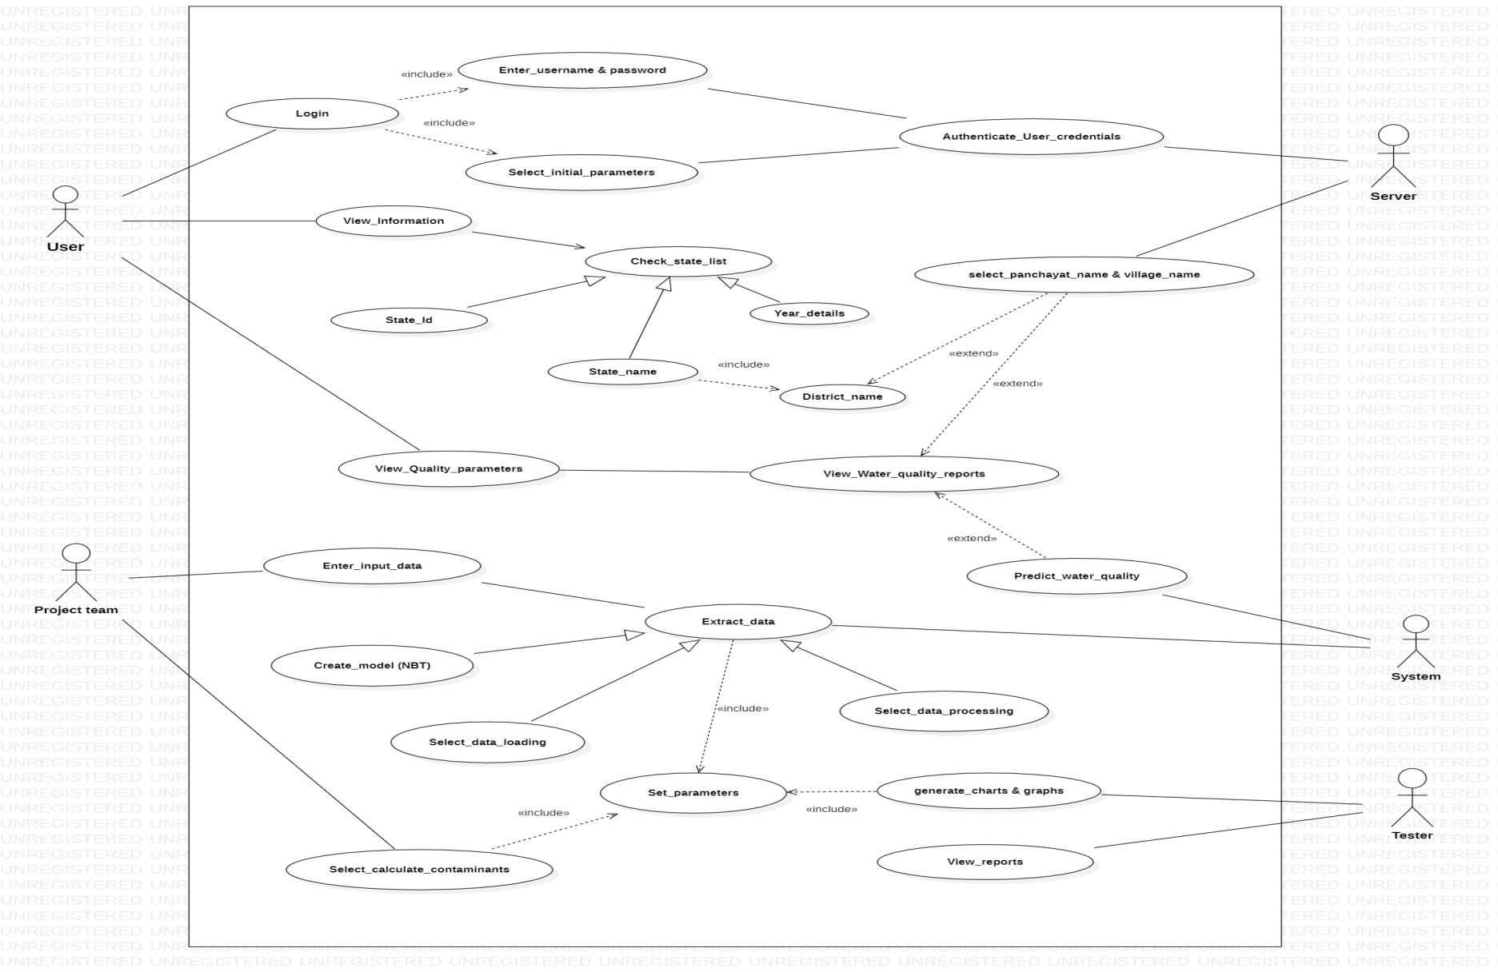
Use-Case Point: Diagram

Slide 68
Use-Case Point:
Use case weights based on the number of transactions:
Actor complexity:
Use case Complexity | Number of Transaction | Weight
Simple | 3 or fewer | 5
Average | 4 to 7 | 10
Complex | More than 7 | 15
Actor Type | Weight
Simple | 1
Average | 2
Complex | 3

Slide 69
Use-Case Point: UAW
Unadjusted Actor Weight (UAW): Table
UAW = (Total No. of Simple Actors x 1) + (Total No. Average Actors x 2) + (Total No. Complex Actors x 3)
For the Total system: UAW= Total of product : 1+0+12
UAW= 13
Actor Type | Weight | Number of Actors | Product
Simple | 1 | 1 | 1
Average | 2 | 0 | 0
Complex | 3 | 4 | 12

Slide 70
Use-Case Point: UUCW
Unadjusted Use Case Weight (UUCW): Table
UUCW = (Total No. of Simple Use Cases x 5) + (Total No. Average Use Cases x 10) + (Total No. Complex Use Cases x 15)
For the Total system: UUCW= Total of product : 35+90+105
UUCW= 230
Use case Complexity | Weight | Number of use cases | Product
Simple | 5 | 7 | 35
Average | 10 | 9 | 90
Complex | 15 | 7 | 105

Slide 71
Use-Case Point: VAF
Scale For validation: 0 - No Influence 1 - Incidental 2 - Moderate
3 - Average 4 - Significant 5 - Essential
Number | Complexity Weighting Factor | value
1 | Data Communications | 3
2 | Distributed data Processing | 2
3 | Performance | 4
4 | Heavily Used Configuration: | 2
5 | Transaction Rate | 3
6 | On-line Data Entry | 1
7 | End-User Efficiency | 2
8 | On-line Update | 0
9 | Complex Processing | 3
10 | Reusability | 4
11 | Installation Ease | 3
12 | Operational Ease | 3
13 | Multiple Sites | 4
14 | Facilitate Change | 3
 | Total Complexity Adjustment value | 37

Slide 72
Use-Case Point: AUCP
Unadjusted Use Case Points: UUCP = UAW + UUCW
From the Calculations already found UAW= 13 and UUCW= 230
UUCP: 13+230 = 243
Value Adjustment Factor:
VAF = 0.65 + 0.01 ∑ (Complexity Weighting Factor values)
VAF = 0.65+(0.01*37)= 0.65 + 0.37
VAF = 1.02
(Adjusted) Use Case Points:
UCP = UUCP * VAF
UCP = 243 * 1.02
UCP = 247.86

Slide 73
Burn down Chart:
Sprint Duration: 8 Weeks
No. of Days per Week: 5
No. of Hrs. per Day: 1
No. of Tasks: 8
Velocity: 43 available hours
Hence, total remaining effort at the beginning of sprint is
8*5*1*8 = 320 hrs
Create Estimate Effort:
 | Week 0 | Week 1 | Week 2 | Week 3 | Week 4 | Week 5 | Week 6 | Week 7 | Week 8
Effort Remaining | 43 | 38 | 33 | 28 | 21 | 14 | 10 | 5 | 0

Slide 74
Track Weekly Process:
The daily progress is then captured in the table against each task.
Here the value captured for each day is the estimated effort to complete the task, not the actual effort and it is estimated for both the developers.
Task | Hours | Day 1 | Day 2 | Day 3 | Day 4 | Day 5 | Total
Task 1 | 5 | 1 | 0 | 2 | 1 | 1 | 5
Task 2 | 5 | 0 | 2 | 1 | 1 | 1 | 5
Task 3 | 5 | 1 | 1 | 1 | 0 | 2 | 5
Task 4 | 7 | 0 | 0 | 2 | 2 | 2 | 6
Task 5 | 7 | 1 | 2 | 2 | 0 | 2 | 7
Task 6 | 4 | 0 | 0 | 1 | 2 | 1 | 4
Task 7 | 5 | 0 | 0 | 3 | 1 | 1 | 5
Task 8 | 5 | 1 | 0 | 1 | 1 | 2 | 5

Slide 75
Data Inputs & Actual Effort:
Data Input of Various Tasks:
Feature | Estimate | Week 1 | Week 2 | Week 3 | Week 4 | Week 5 | Week 6 | Week 7 | Week 8 | Hours Left
Task 1,2 | 10 | 5 | 5 | 0 | 0 | 0 | 0 | 0 | 0 | 0
Task 3,4 | 12 | 0 | 0 | 7 | 5 | 0 | 0 | 0 | 0 | 0
Task 5,6 | 11 | 0 | 0 | 0 | 0 | 7 | 4 | 0 | 0 | 0
Task 7,8 | 10 | 0 | 0 | 0 | 0 | 0 | 0 | 5 | 5 | 0
Compute the Actual Effort:
 | Week 0 | Week 1 | Week 2 | Week 3 | Week 4 | Week 5 | Week 6 | Week 7 | Week 8
Ideal Burn down | 43 | 37.625 | 32.25 | 26.87 | 21.5 | 16.15 | 10.75 | 5 | 0
Effort remaining | 43 | 38 | 33 | 28 | 21 | 14 | 10 | 5 | 0

Slide 76
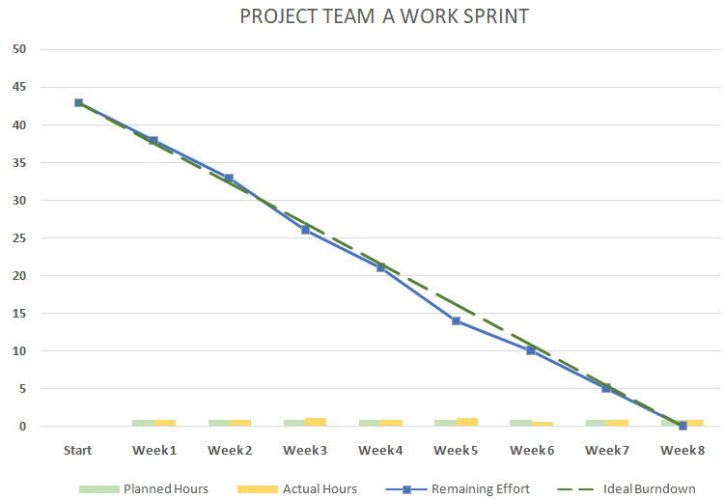
Burn down Chart:

Slide 77
Productivity Metrics:
Particulars | Value
Output | 494
No. of Labors | 2
No. of Months | 3
No. of Working Days per Month | 20
No. of Working Hours per Day | 1
Input of Man Hours is calculated using the formula given below
Input = No. of Labors * No. of Months * No. of Working Days
per Month * No. of Working Hours per Day
Input | 120
Productivity of the Employees is calculated using the formula given below
Productivity = Output / Input
Productivity | 4.1
It helps to track and measure how efficient my team is in getting their tasks done.
As the Manager of my team I want to assess the productivity of the two developers in the team.
According to the tasks that they have completed and the loc that they have produced , here the required number of Developers are 2 and they worked for 3 months and 1 hour per day in the working days they have been allotted

Slide 78
Productivity Metrics:
Developer | Chandana | Surya
No. of Months Served | 3 | 3
No. of Cases Executed | 15 | 13
Productivity is calculated using the formula given below
Productivity = No. of Cases Executed / No. of Months Served
 | Chandana | Surya
Productivity | 5.0 | 4.3
Tester | Tharuni
No. of Months Served | 2
No. of Cases Executed | 12
Productivity is calculated using the formula given below
Productivity = No. of Cases Executed / No. of Months Served
 | Tharuni
Productivity | 6.0

Slide 79
DEVELOPER: V SURYA KAMAL
Supervisor
Dr. Nancy Victor
Assistant Professor, SITE
V Surya Kamal
18MIS0090

Slide 80
Developer 1: Work
Gather information on water degradation.
Coding on Anaconda Python Environment.
Obtaining data description based on requirement and identifying most frequent itemset based on particular parameters.
Plotting Histogram graph for various parameters
Ranking based on frequency of parameters in each state- top 5 states with highest parameter values identified and plotted (Ordinal Scale).
Obtaining and Analyzing trends using various attributes.
Calculating Lines of Code and Halstead Metrics.
Regular and mutual discussion with my colleague developer Chandana Shreya, updating my progress to Team Manager Ashok, block wise testing with tester Tharuni.
Rectifying the identified defects in various modules of the code. Identifying areas for modification in existing programs and subsequently developing these modifications.

Slide 81
Metrics Used:
Lines Of Code
Halstead’s Metrics
McCabe’s Cyclomatic Complexity
Maintainability Index
Programmer Productivity

Slide 82
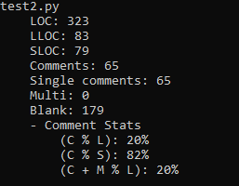
Metrics:
Lines of Code
Source Lines of Code (SLOC) = 79
Comment Lines Of Code & Blank Lines(CLOC)
= 65+179
- LOC = NLOC(SLOC) + CLOC = 79+ 244 =323
Density of comments in program) CLOC/LOC
= 244/323=0.755
C % L: the ratio between number of comment lines and LOC (In percentage)
= (65/323)*100= 20.1
C % S: the ratio between number of comment lines and SLOC (In percentage)
= (65/79)*100= 82.3

Slide 83
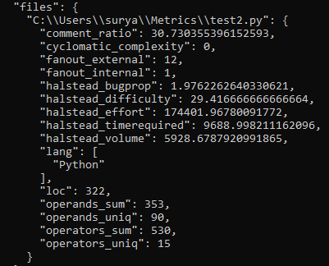
Halstead’s Metrics
- Number of distinct operators in the program (μ1)-- 15
- Number of distinct operands in the program (μ2)– 90
- Total number of occurrences of operators in the program (N1)--530
- Total number of occurrences of operands in the program (N2)--353
- Program vocabulary (μ): μ = μ1 + μ2 ==105
- Program length(N) : N=N1+N1== 883
- Program volume:
V =Nlog2 μ=(N1+N2)log2 (µ1+µ2 )
= 5928.68
Program level:
L=1/D
= (2/ μ1) × (μ2/N2) == 0.034
Program estimated length:
ˆN = µ1 log2 µ1+ µ2 log2 μ2 == 642.87
- Effort: E=V×D= V/L = (μ1xN2/2xμ2) × Nlog2(μ) = 174372.94
- Time required to program: T=E/β == 9687.39
- Remaining bugs: B=E(²/ ³)/3000 == 1.04

Slide 84
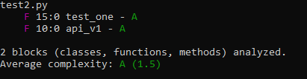
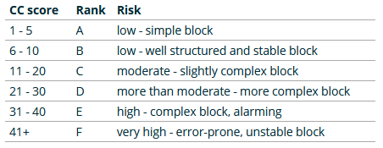
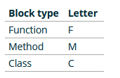
McCabe’s Cyclomatic Complexity
Cyclomatic complexity is a software metric used to indicate the complexity of a program.
2 Functions have been identified and their respective Cyclomatic Complexities are ranked as A based on Risk of the block. The average Cyclomatic Complexity obtained is 1.5

Slide 85
Maintainability Index:
Maintainability Index is a software metric which measures how maintainable the source code is.
MI=171−5.2ln V−0.23 G−16.2ln L
V is the Halstead Volume
G is the total Cyclomatic Complexity
L is the number of Source Lines of Code (SLOC)
MI = 171 - (5.2*ln(5928.68)) - (0.23*1.5) - (16.2*ln(79))
MI = 54.69
Programmer Productivity:
Programmer Productivity is the degree of the ability of an individual programmer to build and evolve software systems.
Programmer Productivity = LOC Produced / Person Months of Effort
= 323/ 2 = 161.5

Slide 86
DEVELOPER: P CHANDANA
Supervisor
Dr. Nancy Victor
Assistant Professor, SITE
P Chandana Shreya
18MIS0041

Slide 87
Developer 2: Work
As a developer for our project I did the task which is coding through anaconda python.
Writing the program codes and reporting.
Measuring the aspects of software quality.
Obtaining attributes from data and writing it in python language.
Installing certain needed libraries for better outcome.
Identifying the water quality parameters and showing the results in visualization.
Accessing if the code is ready for next testing stage.
Consistently trying to produce perfect results in the context of coding and implementation of the quality assessment using the Anaconda .
Updating the work progress with the team manager and remote pairing with my colleague Surya kamal in case needed and checking on each other.

Slide 88
Metrics Used:
Lines Of Code
Halstead’s Metrics
McCabe’s Cyclomatic Complexity
Code Churn Metrics (at the beginning)
Code Churn Metrics (at the end)

Slide 89
Metrics:
Lines Of Code:
The most commonly used measure of source code program length is the number of lines of code (LOC)
From the python code:
SLOC: The number of source lines of code(NCLOC) == 59
Comments: The number of comment lines== 28
Blanks: The number of blank lines == 84
- CLOC= Comments+ blanks=28+84=112
By measuring NCLOC and CLOC separately we can define:
total length (LOC) = NCLOC + CLOC = 59 + 112= 171
- The ratio: CLOC/LOC measures the density of comments in a program.

Slide 90
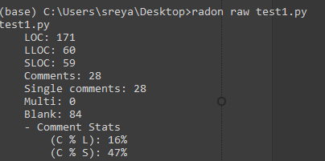
- CLOC/LOC = [112/172=0.651]
C % L: the ratio between number of comment lines and LOC (In percentage) = (28/171)*100= 16.3
C % S: the ratio between number of comment lines and SLOC (In percentage) = (28/59)*100= 47.5

Slide 91
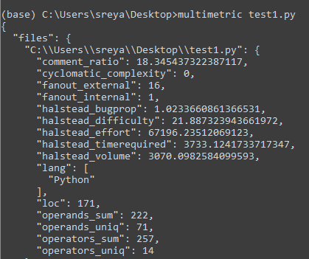
Halstead's work:
Number of distinct operators in the program (μ1)-- 14
Number of distinct operands in the program (μ2)-- 71
Total number of occurrences of operators in the program
(N1)--257
Total number of occurrences of operands in the program
(N2)--222
Program vocabulary (μ): μ = μ1 + μ2 ==85
Program length(N) : N=N1+N1==479
Program volume:
V =Nlog2 μ=(N1+N2)log2 (µ1+µ2 ) ==
3070.0982584099593
Program level: L=1/D= 2/ μ1 × μ2/N2 == 0.046
Program estimated length:
ˆN = µ1 log2 µ1+ µ2 log2 μ2 == 489.94
Effort: E=V×D=
V/L = μ1N2/2 μ2 × Nlog2 μ == 67196.23
Time: T=E/β == 3733.12
Remaining bugs: B=E(²/³)/3000 ==0.551

Slide 92
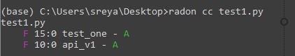
Cyclomatic complexity:
The cyclomatic complexity is a measurement of the code complexity proposed by McCabe which allows us to measure the complexity of a program.
Here the average complexity is A (1-5)

Slide 93
Code churn metrics: (at the beginning)
Measure | Description | Count
Code Churn Count | The number of times that the files are changes | 0
Lines Added | The number of lines of code added in between. | 30
Lines Deleted | The number of lines of code deleted . | 49
Lines Modified | The number of lines of code that the team modified during the time period. | 23
Total Churn | Churn in the code, computed as: [Lines Added] + [Lines Deleted] + [Lines Modified]. | [30]+[49]+[23]=102

Slide 94
Code churn metrics: (at the end)
Measure | Description | Count
Code Churn Count | The number of times that the files are changes | 0
Lines Added | The number of lines of code added in between. | 12
Lines Deleted | The number of lines of code deleted . | 9
Lines Modified | The number of lines of code that the team modified during the time period. | 6
Total Churn | Churn in the code, computed as: [Lines Added] + [Lines Deleted] + [Lines Modified]. | [12]+[9]+[6]=25
At the beginning, the code churn range is 60% which is high and at the end stage of the code the code churn range is 15% which is totally good performance of the programming team and the efficiency of the code is 80% which can be said through the code churn reports.

Slide 95
TESTER: M THARUNI
Supervisor
Dr. Nancy Victor
Assistant Professor, SITE
M Tharuni
18MIS0053

Slide 96
Tester: Work
Assess the faults that occur within the code developed.
Testing is done using pytest which is an inbuilt package of Anaconda.
While testing I need to cross-check with the requirements to make sure that the produced results are according to the stakeholder’s requirements.
Performing unit testing.
Validating that each unit of the software code performs as expected.
I had written some simple unit testing test cases to find the error in the code line by line.
Analyzing whether the output images (Bar graphs) are the same as the expected result.
Updating the final report to the team manager.

Slide 97
Metrics Used:
Code coverage
Code error density
Defect escape ratio
Defect density
Defect density per KLOC
Defect removal efficiency
Test Metrics

Slide 98
Metrics
Code coverage:
It is a software testing metric that determines the number of lines of code that is successfully validated under a test procedure, which in turn, helps in analyzing how comprehensively a software is verified.
Code coverage percentage = [No. of lines of code executed by testing algorithm/total no. of lines in a system component]*100.
- Code coverage for Test1 = [171/171]*100 = 100%
- Code coverage for Test2 = [323/323]*100 = 100%
- Code coverage for Total Code = [494/494]*100 = 100%
Code error density:
Formula: CED = NCE/KLOC
NCE: The number of code errors detected by code inspections and testing.
CED for Test1 = 2/0.171 = 11.69
CED for Test2 = 3/0.323 = 9.28
CED for Total code = 5/0.494 = 10.12

Slide 99
Defect escape ratio:
Defect Escape Ratio is the ratio of defects filed by customer or end user, for a particular release to the total number of defects for that release (sum of defects filed by QA and Developers before production deployment and the defects filed by customer post deployment).
= 4/4
= 1
Defect Density:
Formula: DD = Total no. of defects/Size of release.
Total Size of release = LOC ( Test1+ Test2) = 171+323 = 494
DD = 4/494
= 0.008

Slide 100
Defect Density per KLOC:
It is the number of defects per 1000 lines of code modified / created.
= DD/ KLOC
= 0.008/0.494
= 0.0161
Defect removal Efficiency:
Defect Removal Efficiency (DRE) in essence is a Measure of filtering ability of Quality Assurance and Control activities as they are applied through all Process Framework Activities.
DRE is a Quality Assurance Metrics that provides benefits of both the Project and Process level.
Formula: DRE=E/ (E + D)
(E): No. of Errors before delivery to User.
(D): No. of Defects found by users after delivery.
Total errors for test1 and test2 = 2+3 = 5
DRE = 5/(5+0)
= 1

Slide 101
Test Metrics: Test cases
Passed Test cases percentage = (Number of test cases passed/Total Number of test cases)*100
= [23/25]*100
= 92%
Failed Test cases percentage = (Number of test cases failed/Total Number of test cases)*100
= [2/25]*100
= 8%
Number of tests run per period time = Number of tests run/Total time
= 25/60
= 0.41

Slide 102
TC ID | FUNCTIONALITY | Test case objective | Result
TC 01 | Import data set | Importing the data file using the path reference. | Passed
TC 02 | Check columns | Checking column names using data.columns | Passed
TC 03 | data['StateName'].unique() | To get unique values of Series object. | Passed
TC 04 | data["StateName"].value_counts() | This method returns the count of unique entries in that column. | Passed
TC 05 | data['QualityParameter'].value_counts() | This method returns the count of unique entries in that column. | Passed
TC 06 | Data.describe() | This method is used for calculating some statistical data | Passed
TC 07 | data['QualityParameter'].groupby(data['State Name']).describe() | This function is used to split the data into groups based on some criteria | Passed
TC 08 | data.groupby("State Name").size() | This function is used to split the data into groups based on some criteria | Passed
TC 09 | State_Data.groupby(['State Name','Quality Parameter','Quality']).count().reset_index() | This function splits the data into groups and provides count of columns and rows | Passed
TC 10 | Searching for a particular state | Represents the states with particular attributes | Passed
TC 11 | ax = sns.barplot(x="count", y ="Quality Parameter", data = TAMIL_NADU) | Gives a boxplot of tamil nadu state for the given attributes | Passed
TC 12 | ax = sns.barplot(x="count", y ="Quality Parameter", data = ANDHRA_PRADESH) | Gives a boxplot of andhra pradesh state for the given attributes | Passed
TC 13 | water['Quality Parameter'].unique() | To get unique values of Series object. | Passed
TC 14 | go.Pie(labels=grouped[col],values=grouped['count'],pull=[0.05,0]) | It provides the pie chart for the quality of water | Passed

Slide 103
TC 15 | go.Scatter(x=vc1[col],y=vc1['count'],name="Salinity") | This provide the scatter plot for the parameters | Passed
TC 16 | df.shape | It used to get a tuple representing the dimensionality of the DataFrame | Passed
TC 17 | df.dtypes | It is used to get the data type of data frame | Passed
TC 18 | df.isnull().sum() | It returns number of missing values in the data set. | Passed
TC 19 | df[df.duplicated(keep=False)] | Checking for duplicates | Passed
TC 20 | df.drop_duplicates(subset=['State Name', 'District Name', 'Block Name', 'Panchayat Name', 'Village Name', 'Habitation Name', 'Quality Parameter', 'Year'], keep=False) | Dropping the duplicates | Passed
TC 21 | sns.countplot(df1['Quality Parameter']) | It provide the count plot for the particular parameter | Passed
TC 22 | Top_count['year'].value_counts().plot(kind='bar',figsize=(9,5),title="Year with highest water degradation") | It provides the bar plot of frequency | Passed
TC 23 | Quality[Quality['Quality']==0]Arsenic.plot('year','count',kind='scatter', layout=(5,5),title= "Arsenic distribution") | It provides scatter plot for the parameters | Passed
TC 24 | Unrecognised variable | Finding a variable which python doesn’t accept. | Failed
TC 25 | Wrong dataset | Importing the wrong path of dataset | Failed

Slide 104
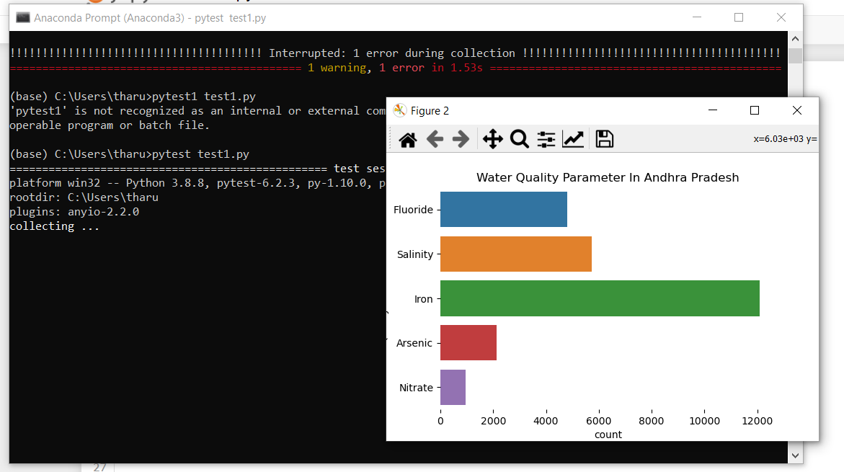

Slide 105
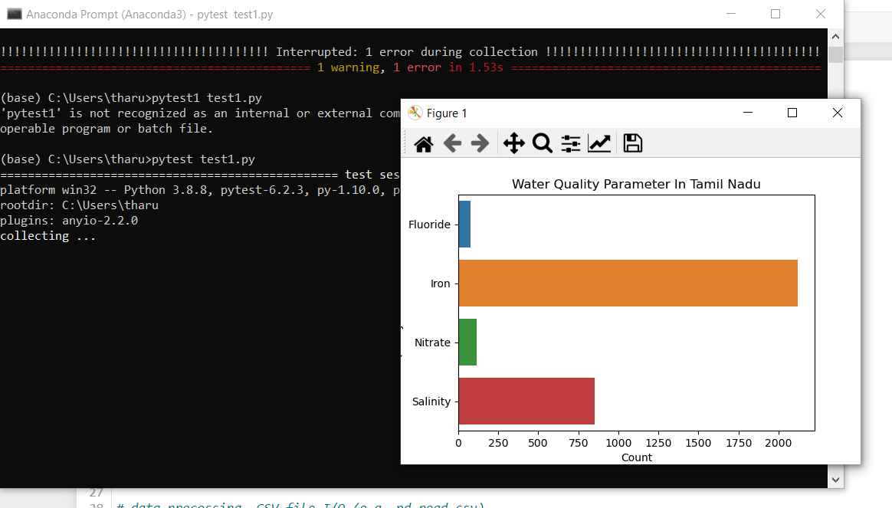

Slide 106
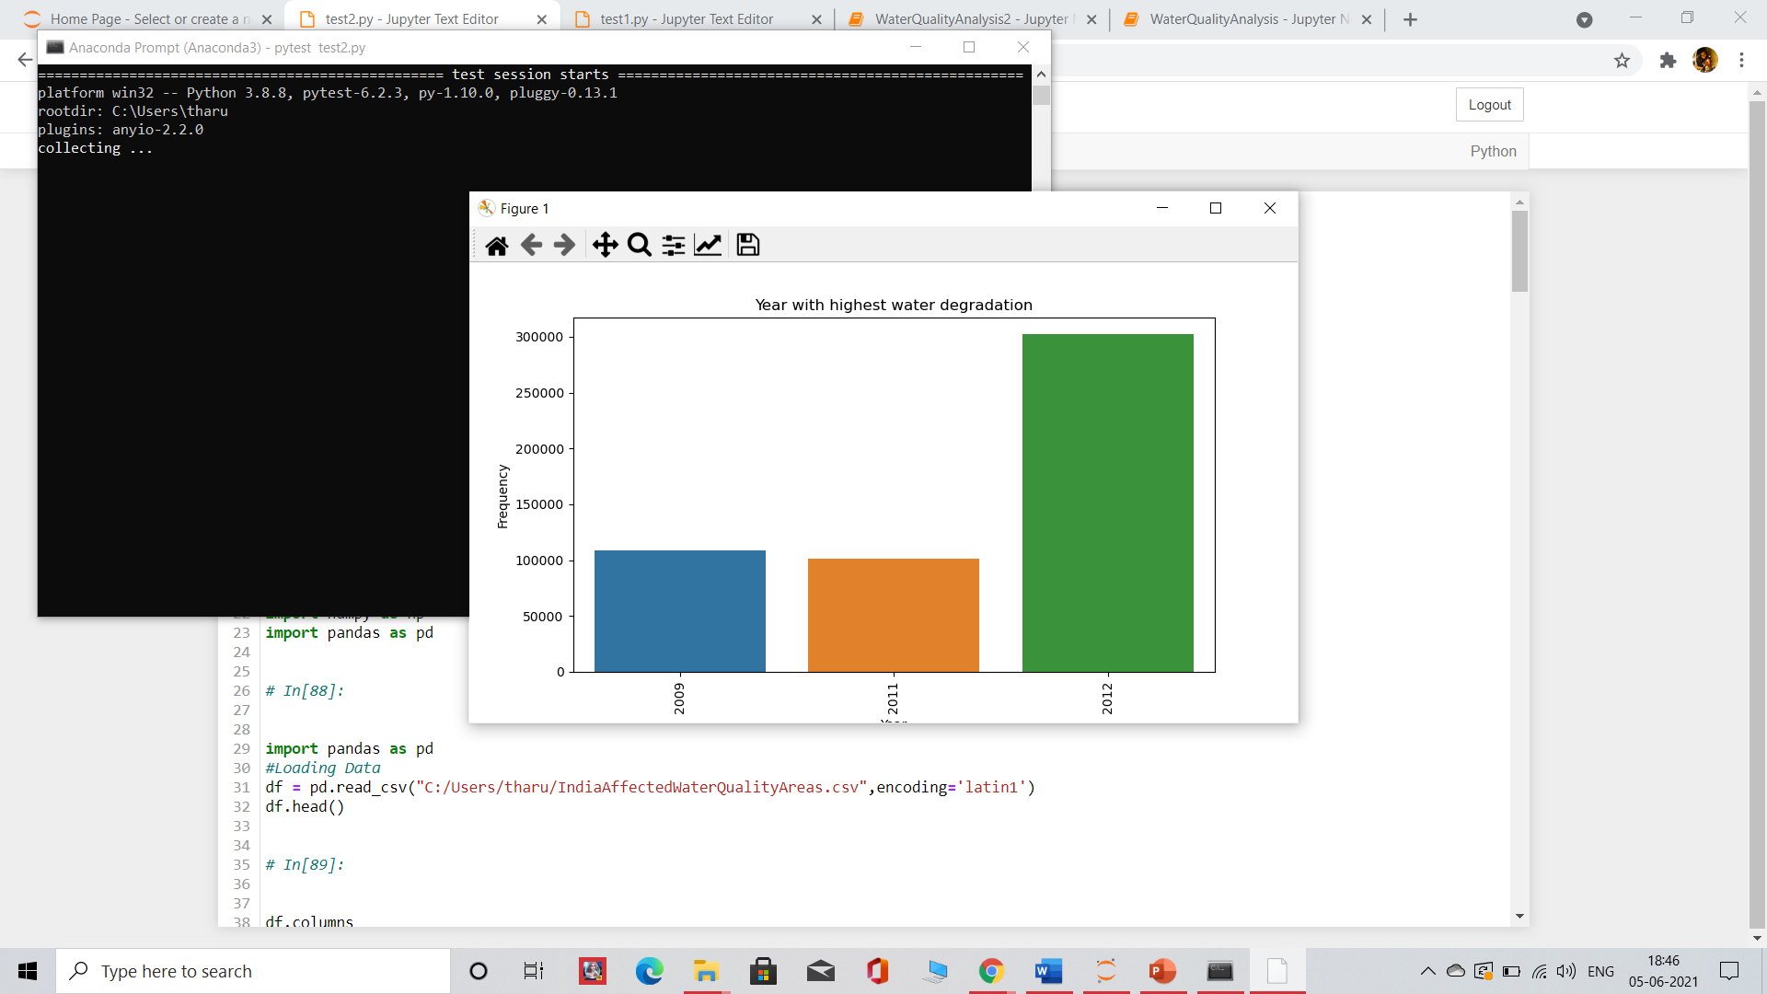

Slide 107
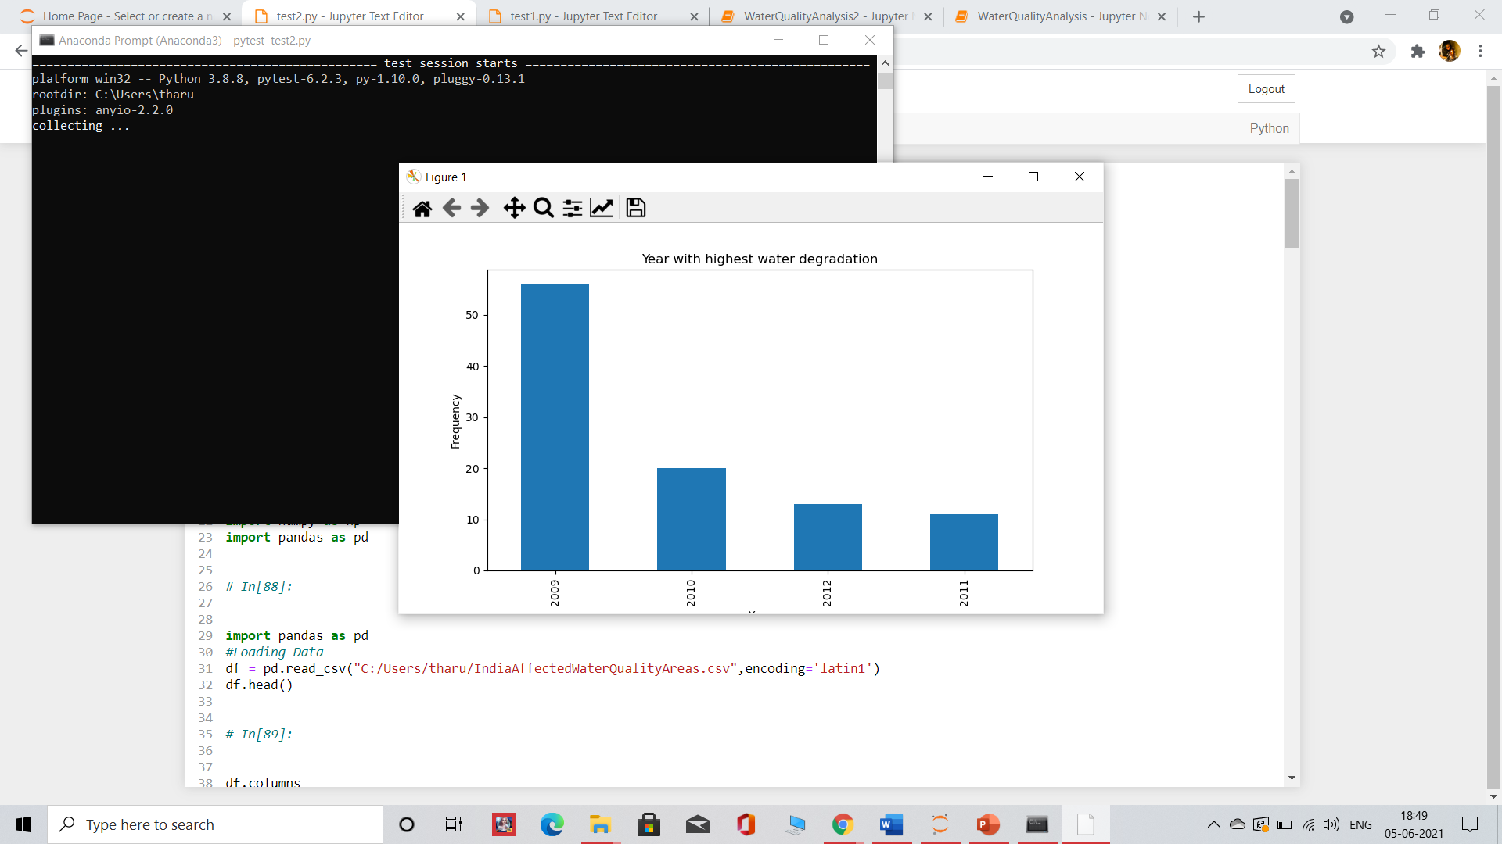

Slide 108
TEAM MANAGER: K SARAYU
Supervisor
Dr. Nancy Victor
Assistant Professor, SITE
K Sarayu
18MIS0069

Slide 109
Team 2 Manager: Work
Prepared a Gantt chart with the schedule dates and made sure that the works are done.
Had a brain storming section to get idea on creating a web portal.
I have created use case to give an idea on web portal and mase it simpler to understand by having a use case done for modules.
Gathered the requirements and required data for creating a web portal with the help of team.
Working in code and implementation part, constant monitoring on the works and getting updates when the work is done from the team members and giving update to project manager.
Calculated the metrics like use case point and object point that express functionality of the system.
Calculated plan to done ratio, programmer productivity and illustrated few metrics to developers and tester.
We have the work load and progress chart. Created using a tool describes the task done by person
Contributed in documenting the report of the project.

Slide 110
Metrics Used:
Use Case Point
Object Point
Plan to Done ratio
Programmer productivity according to module

Slide 111
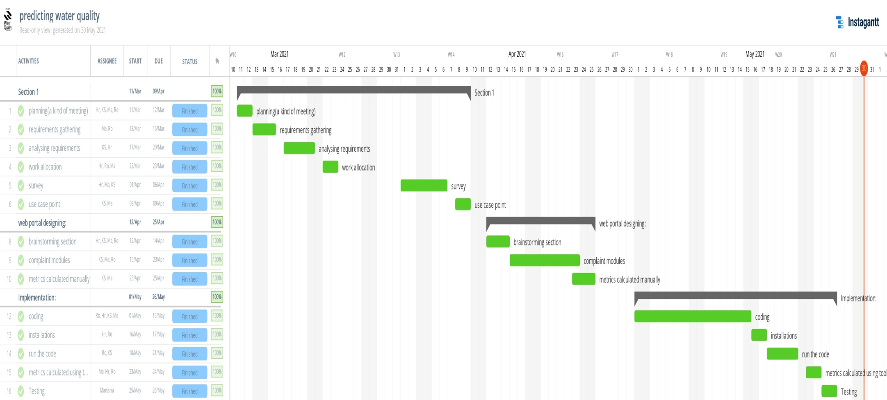
Gantt chart:

Slide 112
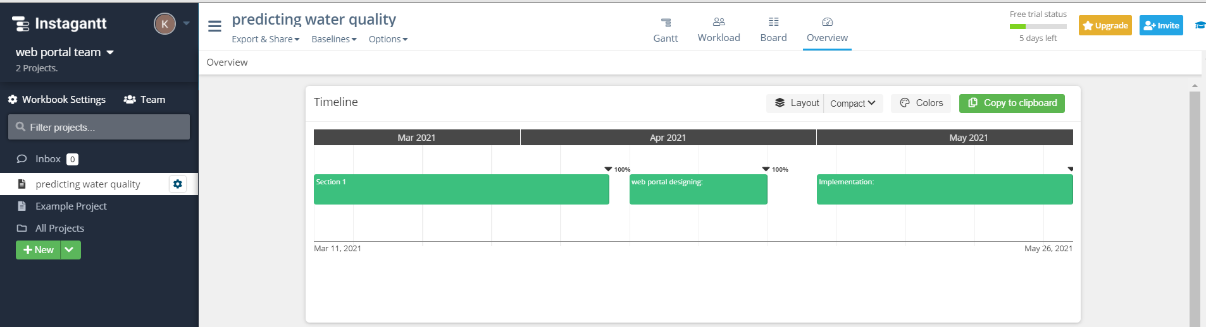
Timeline:

Slide 113
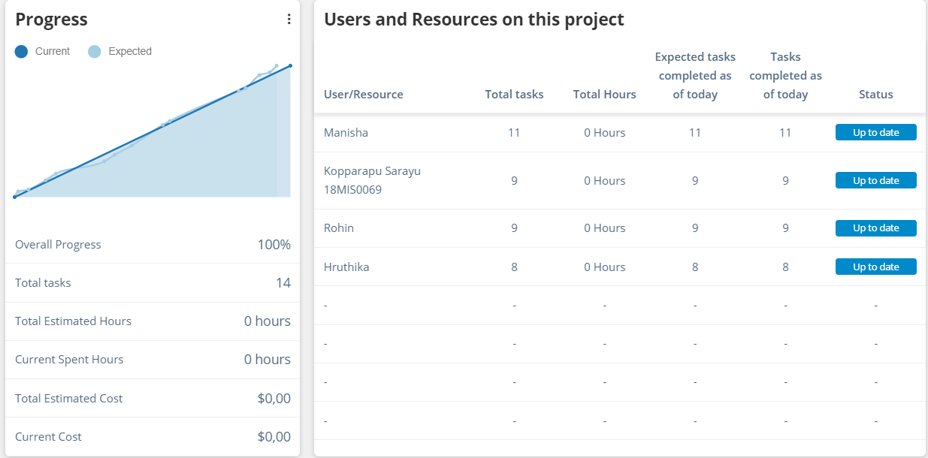
Progress:

Slide 114
Project Resource Requirements:
Deployment:
Operating system server: windows, Linux, Unix
Hardware requirements:
Laptop consisting of any OS like Windows, IOS and Linux can be helpful with internet connectivity.
Software requirements:
We can use any browser (Chrome, Mozilla Firefox, Microsoft Edge)
Xampp should be installed
Tools used are:
Phploc
Instagantt (for Gantt and other charts)
Selenium tool for testing

Slide 115
SRS: (Software Specification Document)
It is a document to describe the behavior of the software system, functional, Non functional requirements of the software system.
Category: Web application
Purpose: The purpose of developing this web portal is to keep users(public) and admins(govt officials) connected through a virtual platform even when they cannot out the officials personally.
Scope: It will integrate the benefits of a physical approach with the convenience of a virtual environment and minus the change hazards and expenses.
Proposed system:
User login
Dashboard
Complaint module
profile

Slide 116
Functional Requirements:
Here functional requirements describe what a system should do. Functional requirements of our system are explained below:
User Module:
ID | Requirement specification/definition
FR 1.1 | User should create an account
FR 1.2 | Login to the system
FR 1.3 | User supposed to enter the credentials
FR 1.4 | System will validate the credentials
FR 1.5 | If invalid then system will not allow user to login
FR 1.6 | It asks user to create the account
FR 1.7 | The details are stored in database
FR 1.8 | Then the details are synced to any of the browser.
FR 1.9 | Incase of wrong credentials user can opt for forgot password option.
FR 2.0 | User can register complaint
FR 2.1 | User have access to change or update the complaints at any time.
FR 2.2 | The system should allow user to logout at any moment.

Slide 117
Non – Functional Requirements:
Requirement that specifies criteria that can be used to judge the operation of a system are called non functional requirements.
Performance:
ID | Requirement specification/definition
NFR 1.1 | The portal should e able to handle multiple user accounts
NFR 1.2 | There should not be any 3rd party distributing the user processes.
NFR 1.3 | The system should able to respond to many users request at same time.
NFR 1.4 | The response of system should be immediate measures the performance.
Compatibility:
ID | Requirement specification/definition
NFR1.1 | The system should run on any operating system like windows,linux,unix…
NFR 1.2 | It should be environment- user friendly .

Slide 118
Usability:
ID | Requirement specification/definition
NFR1.1 | This focuses on the appearance of the user interface and how people interact with it.
NFR1.2 | The font size , play buttons , check boxes should be made according to user comfortability.
NFR1.3 | The system should be easily usable and should navigate to pages easily.
NFR1.4 | The design of the system must be pleasant to use.
NFR1.5 | The system should be efficient for users to register their complaints.

Slide 119
Security:
ID | Requirement specification/definition
NFR1.1 | The access permissions for system data may only be changed by the administrator.
NFR1.2 | Passwords shall never be viewable at the point of entry or at any other time.
NFR1.3 | Every unsuccessful attempt by a user to access the system can be recorded .
Maintainability:
ID | Requirement specification/definition
NFR1.1 | The ease with which a system can be modified. (new patrons addition, password changes, database changes)must be verified once per day atleast.
NFR1.2 | The system should provide automatically notification to patrons by e-mail about the query like pending,addressed it,or approved.

Slide 120
Metrics
Effort Per Team Member
Team member | No. of assigned activities | No. of act performed | No. of weeks worked
Sarayu (Team Manager) | 9 | 9 | 12 weeks
Rohin(Developer) | 9 | 9 | 12 weeks
Hruthika(Developer) | 8 | 8 | 12 weeks
Manisha(Tester) | 11 | 11 | 9 weeks

Slide 121
Use Case diagram:
This method helps us to develop requirements. Use cases are used to validate a proposed design and to ensure it meets all requirements.
Use case point:
For each actor :
Simple actor: [weight – 1] Average actor: [weight– 2] Complex actor:[weight –3]
For each use case:
Simple use case: [weight– 5] Average use case:[weight—10] Complex use case:[weight– 15]
Assuming the overall system to be avg so,
F = 14*3 = 42
VAF = 0.65 =0.01(F)
= 0.65 +0.01*42
= 1.07

Slide 122
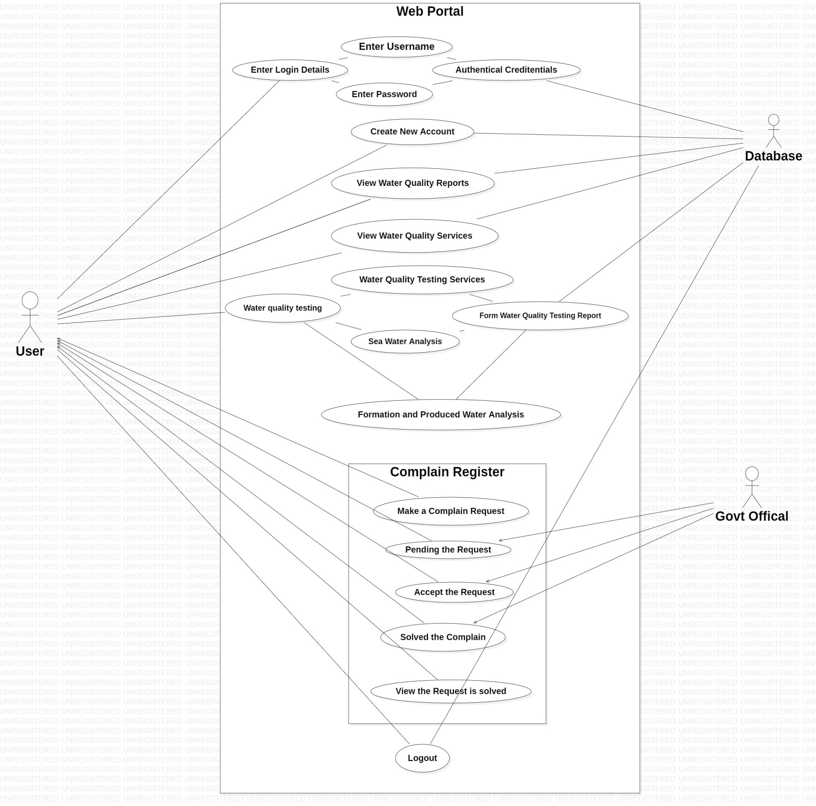

Slide 123
Actors:
- User, govt official: complex
- Database: average
Use case:
Use cases | Weight | No. of use cases | Product
Simple | 5 | 8 | 40
Average | 10 | 5 | 50
Complex | 15 | 5 | 75
UAW:3+3+2 =8
UUCW=40+50+75=165
UUCP:8+165 =173
VAF = 1.07
UCP = UUCP*VAF = 173*1.07= 185.11

Slide 124
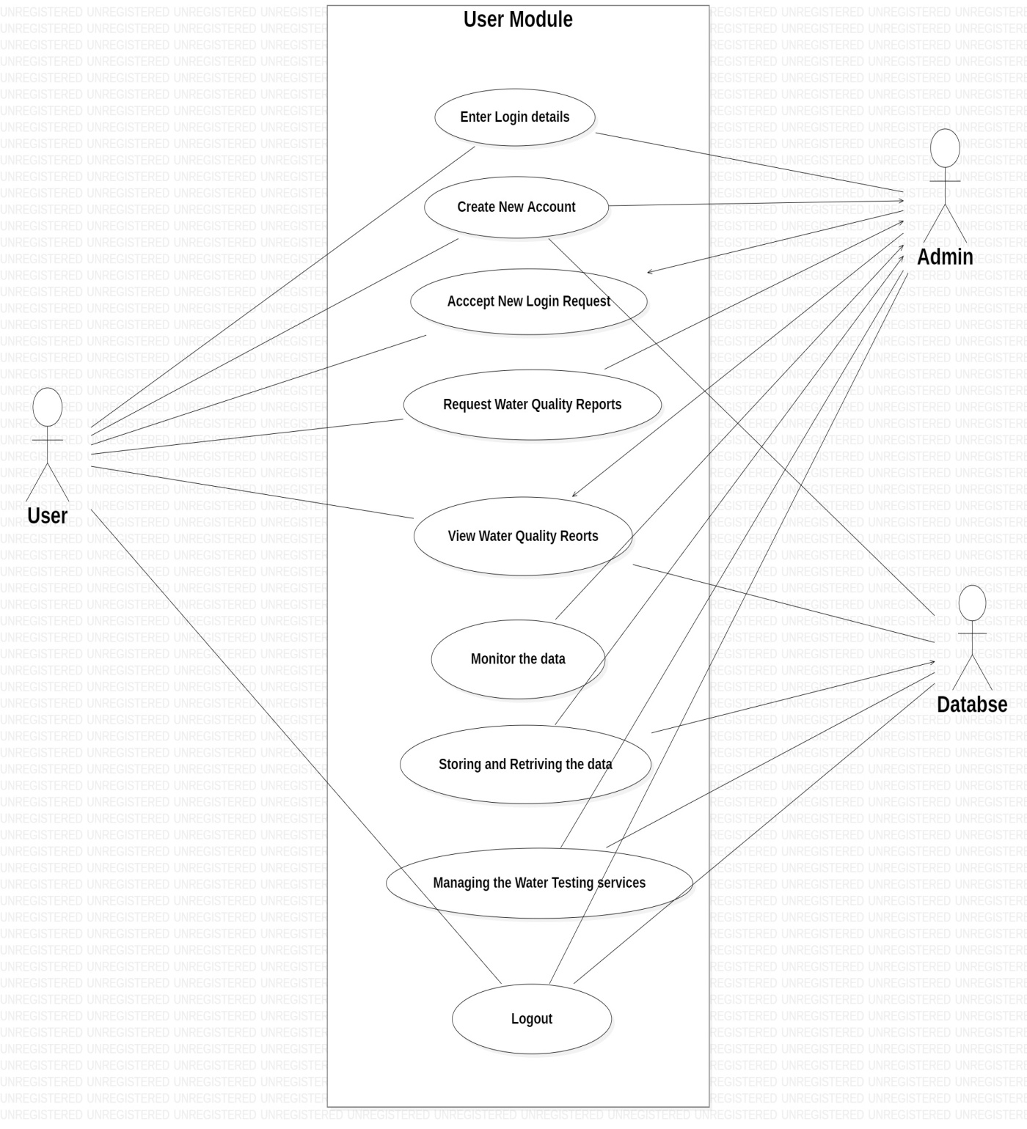

Slide 125
Actors:
User: complex (interacts via GUI)
Database: average (stores data)
Use Case:
Use cases | Weight | No. of use cases | Product
Simple | 5 | 3 | 15
Average | 10 | 3 | 30
Complex | 15 | 3 | 45
UAW=3+2+3=8
UUCW=90
UUCP: UAW+UUCW=8+90=98
VAF = 1.07
UCP = UUCP*VAF = 98*1.07= 104.86

Slide 126
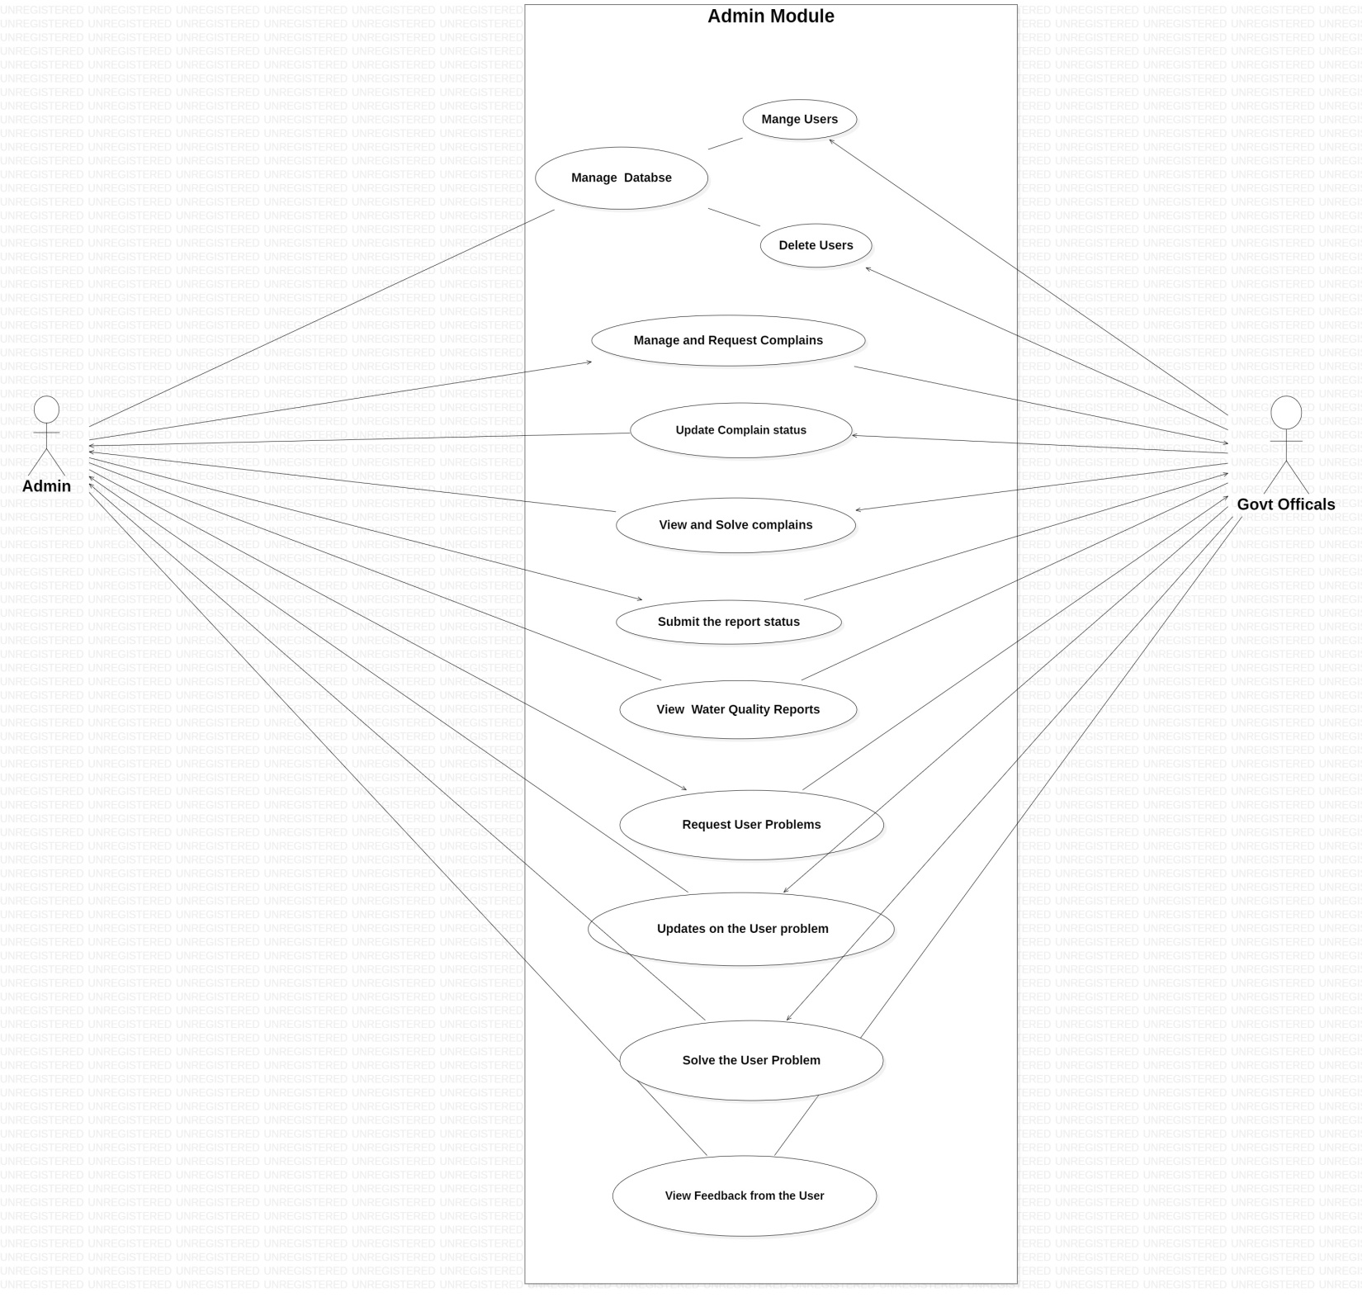

Slide 127
Actors:
- Admin: average
- Govt officials: Complex
Use case:
Use cases | Weight | No. of use cases | Product
Simple | 5 | 3 | 15
Average | 10 | 3 | 30
Complex | 15 | 6 | 90
UAW: 2+3=5
UUCW:135
UUCP: 5+135 = 140
VAF = 1.07
UCP = UUCP*VAF = 140*1.07= 149.8

Slide 128
Object point:
Object points are used as an initial measure for size, so it is done by counting the number of screens, reports, and third generation components that will be used in the application.
Complexity level for object point:
Object type | simple | Medium | Difficult
screen | 1 | 2 | 3
Report | 2 | 5 | 8
3GL component | - | - | 10

Slide 129
Object point for a smart quality water service(web portal) assuming that the system is average size with the data like:
Screens | views(data items)
User screen:
S1: access to system(screen) | Credentials as amount of data to be given as input.
Administrator screens:
S2: Inventory update | Inputs are updated as per customer request(30 data items)
S3: change update | 6 data items
S4: Address the update | Answering to the query or providing a solution.

Slide 130
Reports | views (Data items)
User reports:
R1: Display log in details. | credentials they have entered
R2: not valid deatails entered(invalid) | Incorrect data
R3: Return to sign up page | Directed to home page
R4:Timed out | server time out
R5: Forgot password! Request for new one | sends an mail to re create password
R6: Selection approved | Release selection signal
Administration reports:
R7: Portal access is approved | queries are processed
R8: Report generated | Change or query is addressed

Slide 131
Complexity level for object point:
Simple | Medium | Difficult
s1 | S3, S4 | S2
R1,R2,R3,R4,R5,R6 | - | R7,R8
OP is calculated according to the weights of screens and reports
OP: (1*1)+(2*2)+(1*3)+(2*6)+(5*0)+(8*2)
= 1+4+3+15+16
= 36
Effort: op/PROD
= 36/13
= 2.7692

Slide 132
Plan to done ratio:
The planned-to-done ratio calculates what percentage of the assigned tasks were completed adequately. It also helps in tracking whether the project is getting done in the way we planned them.
In the month february we have divided the work among ourself. And we have started doing activities from march.
This plan to done ratio is according Team 2
Month | Planned activities | Done activities | Plan to done ratio
March | Requirements analysis Literature survey | Requirements analysis Literature survey | 2:2
April | Brain storming section. Designing of modules Finding metrics | Brain storming section. Designing of modules | 3:2

Slide 133
May | Work on coding part Installations of software .Implementation Metrics calculation. testing | Work on coding part Installations of software Implementation Calculated some metrics | 5:4
June | Calculating metrics Testing Documentation | Calculating metrics Testing Documentation | 3:3
Programmer productivity:
It is calculated using the following formula: Loc/person’s month of effort
As we have Complaint module in our web portal according to that the calculation is:
Dashboard: Loc/ person’s month of effort = 2946/4 = 736.5
Configuration: Loc/person’s month of effort => 28/4 =7
Javascript used in portal: Loc/person’s month of effort => 1794/4 =448.5

Slide 134
DEVELOPER: H ROHIN
Supervisor
Dr. Nancy Victor
Assistant Professor, SITE
Rohin Hodkasia
18MIS0126

Slide 135
Developer 1: Work
Implementation of web portal using HTML ,CSS, PHP , XML
Collection of complaints data from stakeholder's
Displaying the quality of water
User friendly Coding for the portal as per user requirements
Updating the announcement as required
Obtain metrics results with the help of LIZARD tool implementation

Slide 136
Metrics Used:
Token Metrics
LOC Metrics
CCN Metrics (Cyclomatic Complexity Number)
Repeatable Metrics
Size Metrics
Productivity Metrics

Slide 137
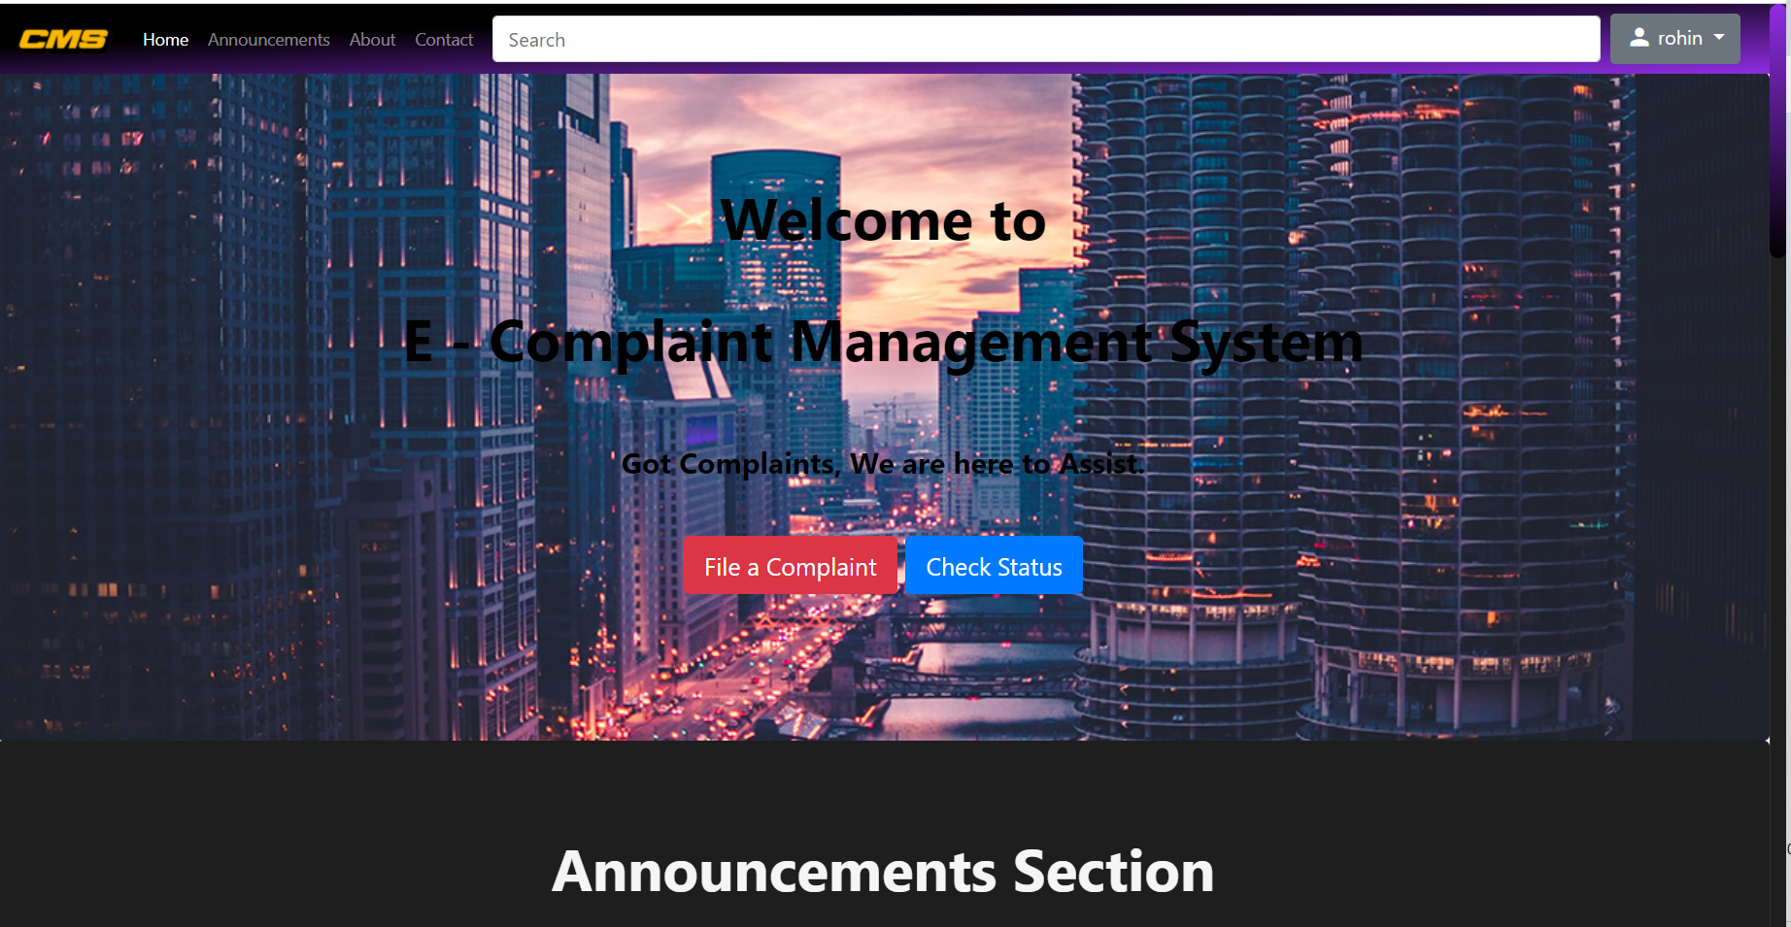
COMPLAINT MANAGMENT SYSTEM

Slide 138
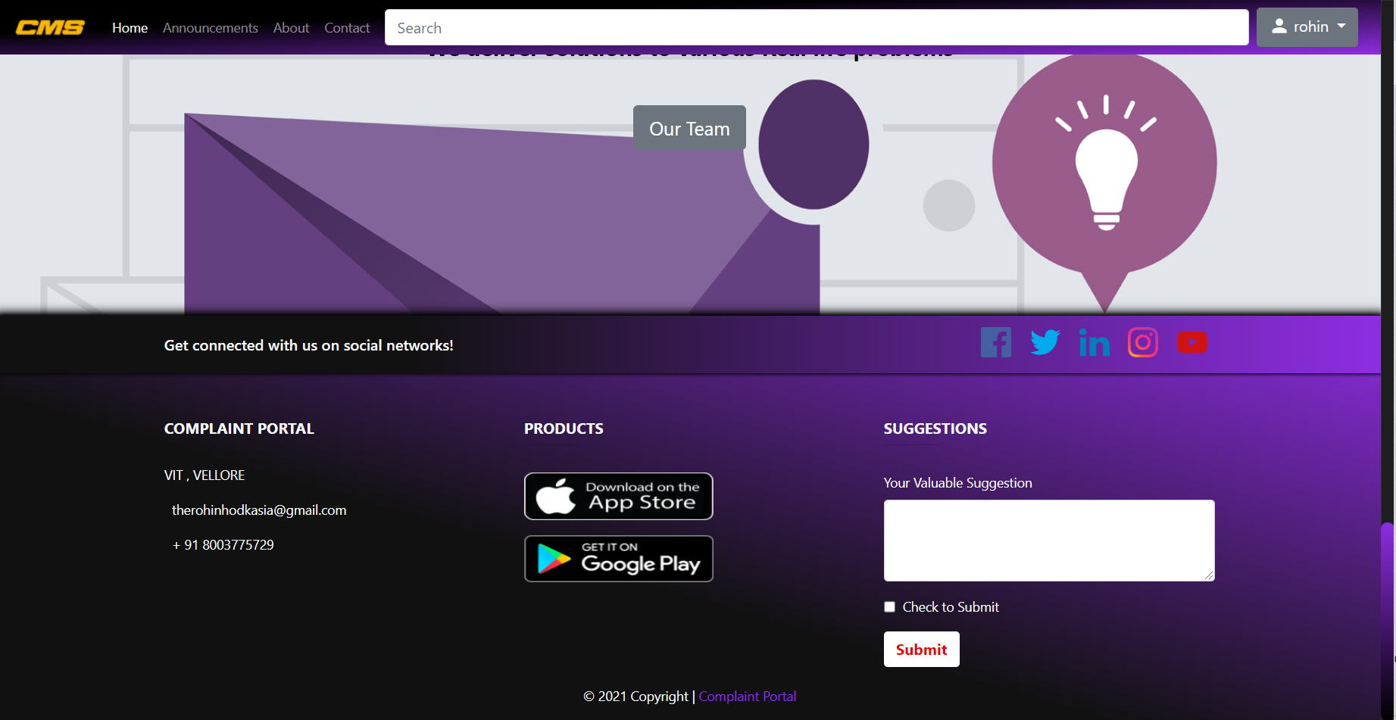
CONTACT DETAILS

Slide 139
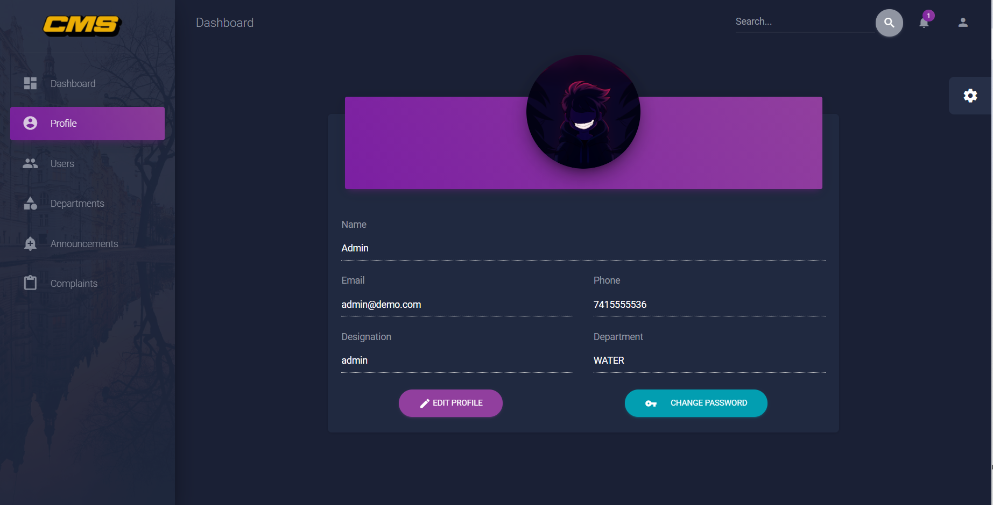
PROFILE (CHANGE PASSWORD)

Slide 140
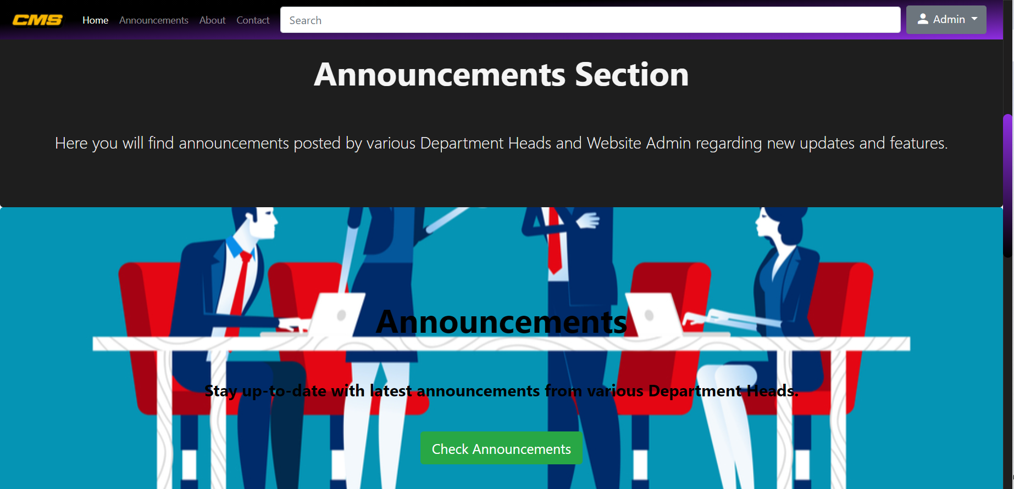
ANNOUNCEMENT SECTION

Slide 141
Metrics
Token metric
In computer science, lexical analysis, lexing or tokenization is the process of converting a sequence of characters (such as in a computer program or web page) into a sequence of tokens
LOC metric
“Lines Of Code” (LOC) is a metric generally used to evaluate a software program or codebase according to its size. It is a general identifier taken by adding up the number of lines of code used to write a program.
CCN Metric (Cyclometric Complexity Number)
Cyclomatic complexity is a software metric used to indicate the complexity of a program. It is a quantitative measure of the number of linearly independent paths through a program's source code. Cyclomatic complexity may also be applied to individual functions, modules, methods or classes within a program.

Slide 142
Repeatable metric
Repeatability or test–retest reliability is the closeness of the agreement between the results of successive measurements of the same measure, when carried out under the same conditions of measurement.
Different groups of users will essentially get the same number
Got the same results of NLOC after trying by more than 2different tools and different users
Size Metric
This metrics is one of simplest and earliest metrics that is used for computer program to measure size. Size Oriented Metrics are also used for measuring and comparing productivity of programmers. It is a direct measure of a Software. The size measurement is based on lines of code computation.
Productivity metric:
Programmer productivity : LOC Produced /Person days efforts

Slide 143
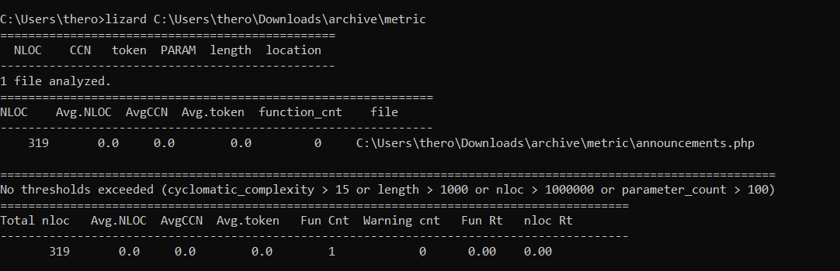
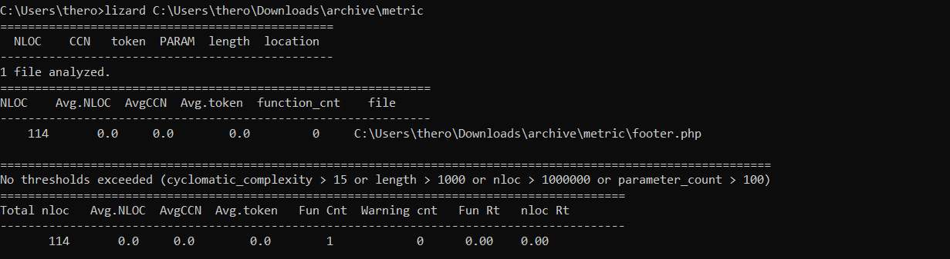

Slide 144
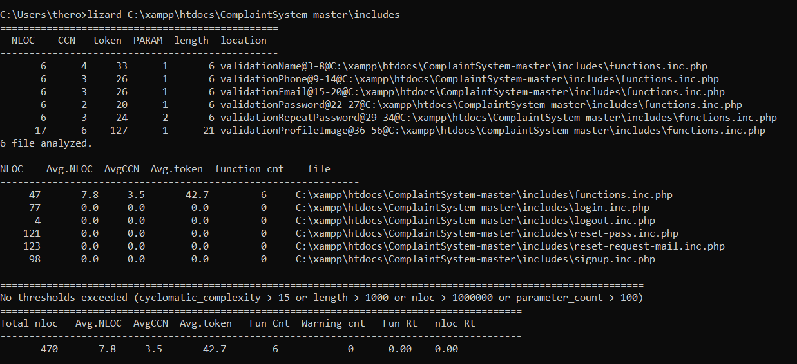
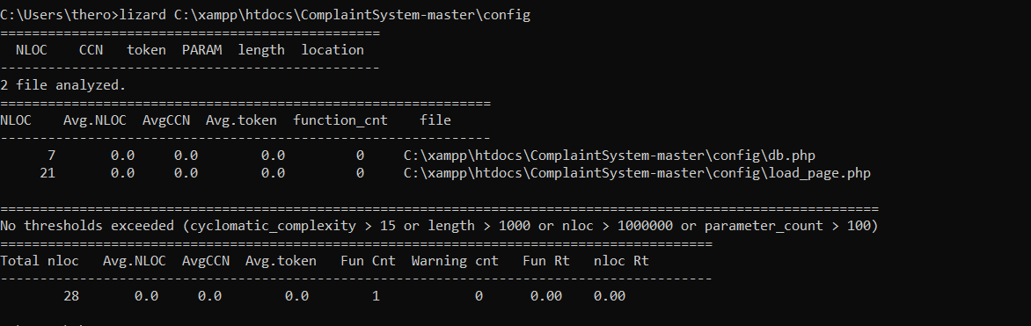

Slide 145
Module | NLOC | Token | Programmer Productivity | AVG.CCN
CONFIGURATION | 28 | 0.0 | 2.8 | 0.0
INCLUDE | 470 | 42.7 | 47 | 3.5
CONTACT DETAILS | 114 | 0.0 | 11.4 | 0.0
PROFILE | 319 | 0.0 | 31.9 | 0.0
ANNOUNCEMENT | 319 | 0.0 | 31.9 | 0.0

Slide 146
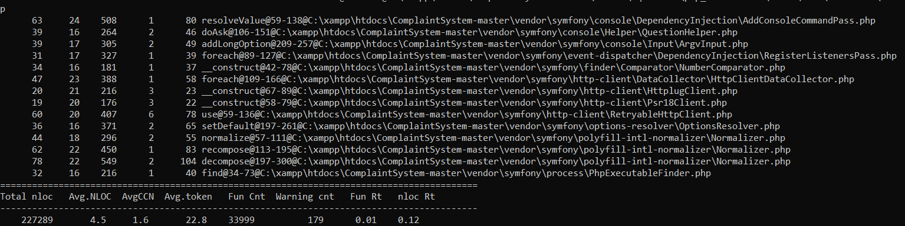
COMPLAINT MANAGMENT SYSTEM
Size metric
LINES Size
0..9999 Small
10,000..49,999 Medium
50,000..99,999 Semi-large
100,000..499,999 Large
500,000.. Very large
Number of lines in portal = 227289
Size = Large

Slide 147
Productivity Metrics:
Programmer productivity : LOC Produced /Person month efforts
227289/2.5 = 90915.6
KLOC = 227289/1000 =2272.89
CCN Metric : avg CCN : 1.6
Token metric: 22.8

Slide 148
DEVELOPER: B HRUTHIKA
Supervisor
Dr. Nancy Victor
Assistant Professor, SITE
B Hruthika
18MIS0037

Slide 149
Developer 2: Work
Designing a web portal which is easy to access and user friendly.
Gathering the information of water quality through webportal.
Checking the complaints received from the user.
Storing the data acquired from the forms in a record.
Calculated metrics for Php files.

Slide 150
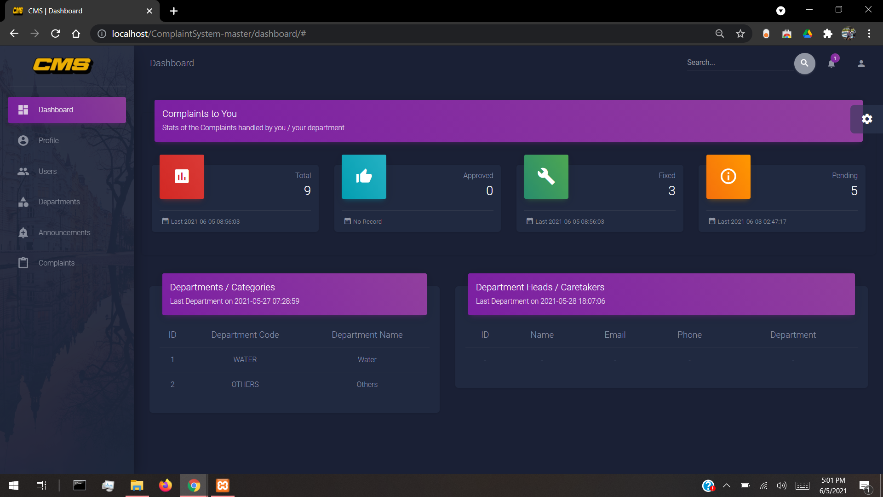
Dashboard

Slide 151
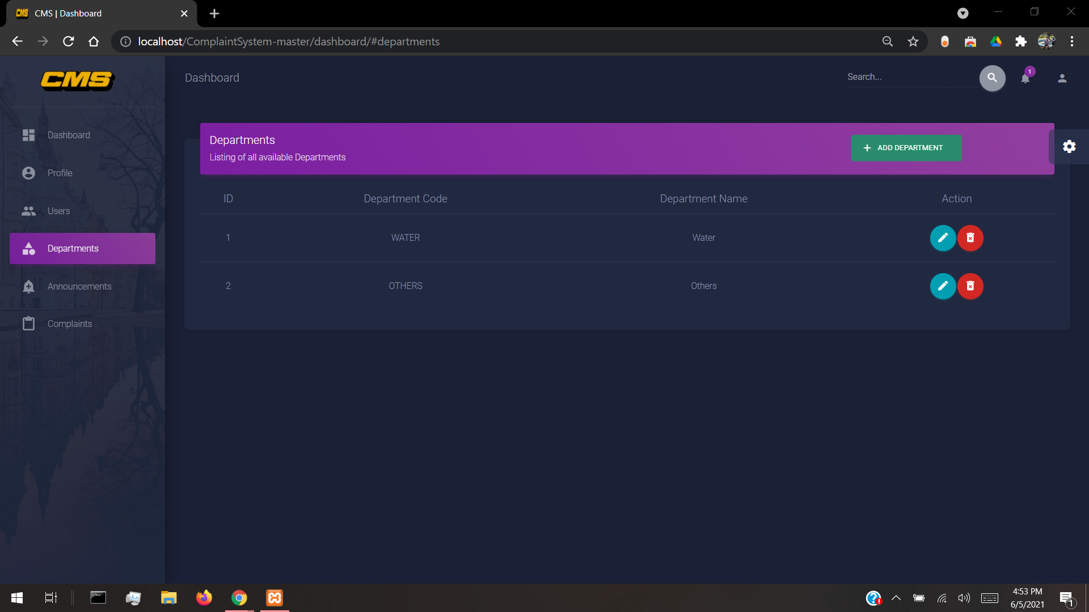
Departments

Slide 152
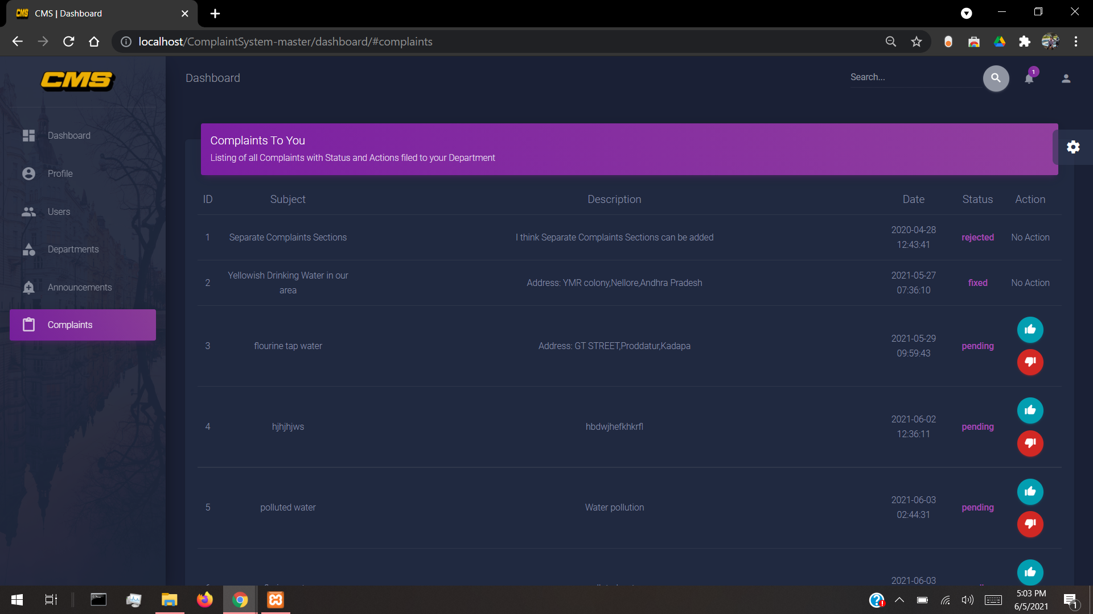
Complaints

Slide 153
Metrics Used:
Lines Of Code
Productivity Metrics
Team Velocity
Cyclomatic Complexity

Slide 154
Lines of code:
Metrics
Lines of code (LOC), is a software metric used to measure the size of a computer program by counting the number of lines in the text of the program's source code.
NLOC: Non-commented lines of code
CLOC: commented lines of code
CLOC = 328
NCLOC = 8316
LOC = NCLOC+CLOC = 8644
Density of comments in the program:
Ratio = CLOC/LOC = 0.0379

Slide 155
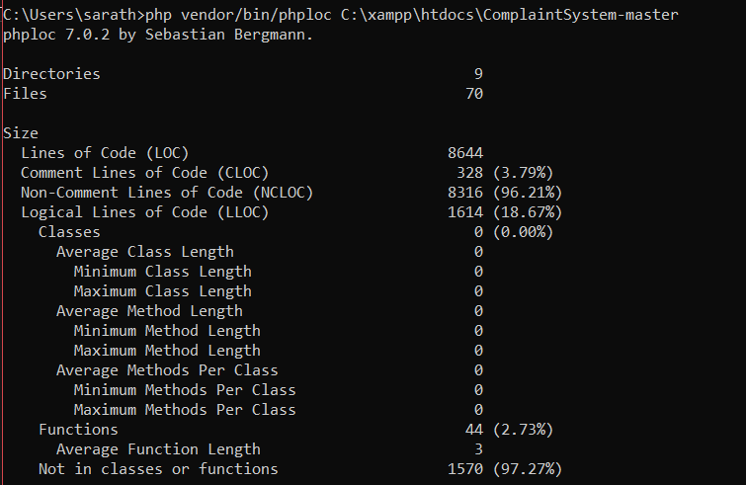

Slide 156
Productivity metrics:
Productivity metrics are used to track and measure how efficient your team is in getting their tasks done.
productivity=LOC produced/Person month efforts
=8644/2 =4322
Team Velocity:
Team velocity measures the number of story points, quantifying the number and size of product features, completed by the team in the previous sprints. It helps to understand how much value the team is providing to customers in a given time period.

Slide 157
Sprint 1: 3 user stories x 8 story points = 24
Sprint 2: 4 user stories x 8 story points = 32Sprint 3: 5 user stories x 8 story points = 40
Total = 24+32+40=96
Average sprint velocity= 96/3 = 32.
Cyclomatic complexity:
Cyclomatic complexity is a source code complexity measurement that is being correlated to a number of coding errors. It is calculated by developing a Control Flow Graph of the code that measures the number of linearly-independent paths through a program module.
For php files
Average cyclomatic complexity =0.26

Slide 158
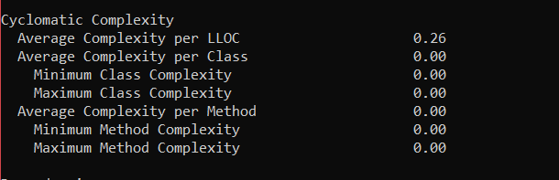

Slide 159
TESTER: T MANISHA
Supervisor
Dr. Nancy Victor
Assistant Professor, SITE
T Manisha
18MIS0329

Slide 160
Tester: Work
Developing and executing the Test Cases for all requirements in project.
Testing each module in project using Selenium web driver.
Calculating the Test metrics, Code coverage, Test execution coverage and Defect density.
Documenting the tests and bugs.
Updating the bug reports to the developers and Team manager.
Informing the team manager about what all resources will be required for software testing.
Attending regular meetings with team members and giving suggestions to get the bug-free product.

Slide 161
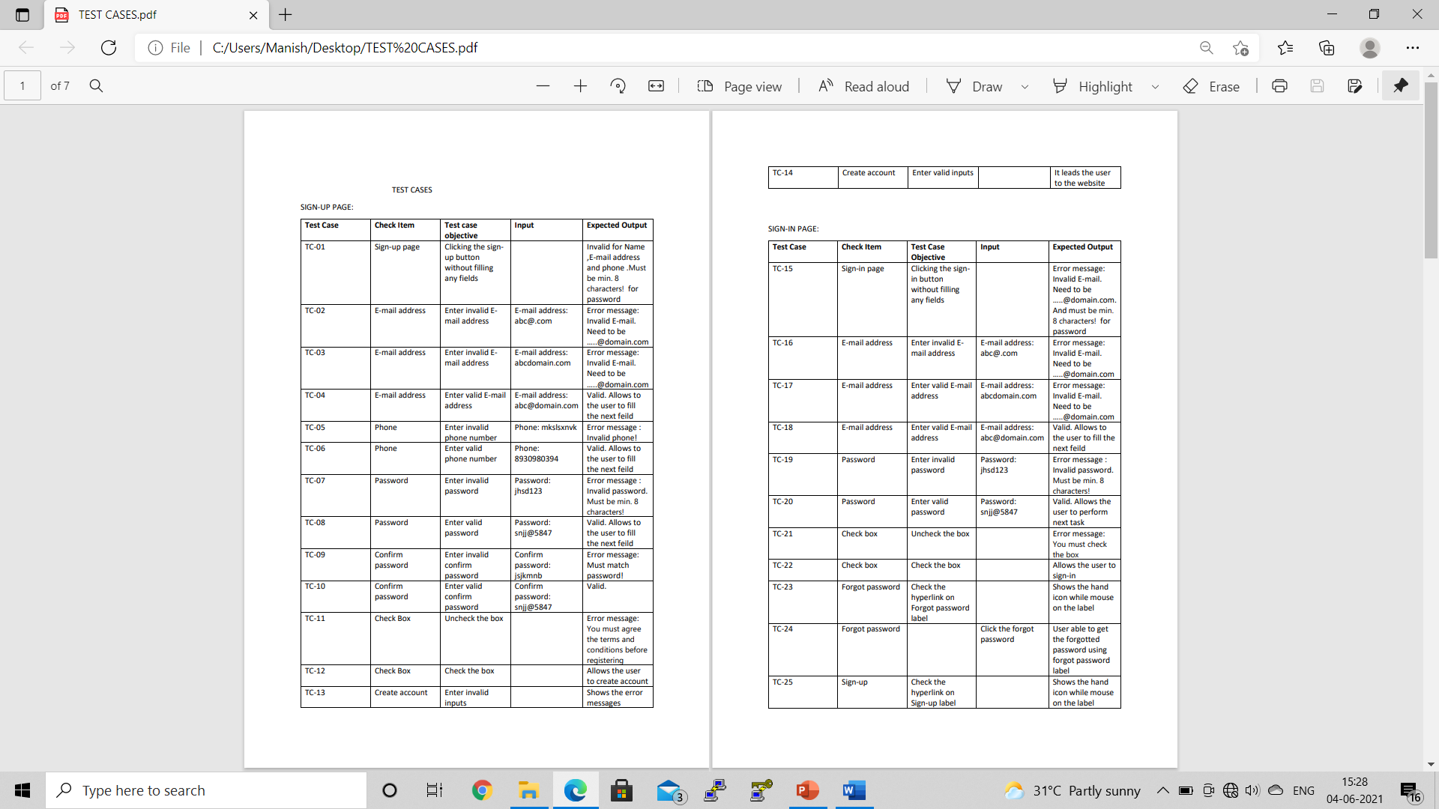
Test cases:

Slide 162
Test cases:

Slide 163
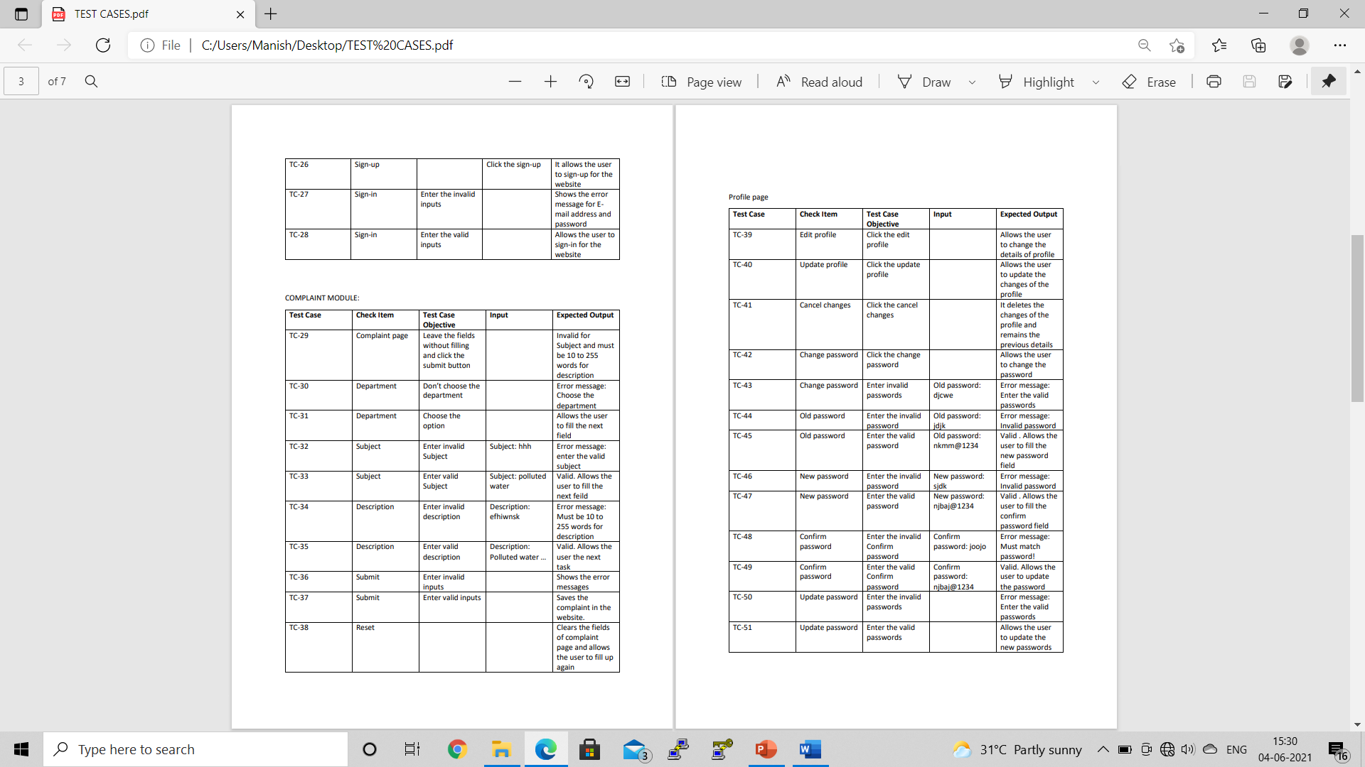
Test cases:

Slide 164
Test cases:

Slide 165
Metrics Used:
Testing Metrics
Code Coverage
Code Coverage percentage
Test Execution coverage
Defect Density

Slide 166
Metrics
Testing metrics:
- No. of requirements=4
- Total No. of test cases written for all requirements=51
- Avg No. of test cases written for each requirement = 12 (51/4)
- Total No. of test cases executed=26
- No. of test cases passed=14
- No. of test cases failed=9
- No. of test cases blocked=2
- Total No. of defects identified=13
- No. of test cases unexecuted=11

Slide 167
Code coverage
Code coverage is a software testing metric that determines the number of lines of code that is successfully validated under a test procedure, which in turn, helps in analysing how comprehensively a software is verified.
LOC for Complaint System-master= 4322
Number of lines of code executed by a testing algorithm= 4158
Code Coverage Percentage
Code Coverage percentage= (Number of lines of code executed by a testing algorithm/Total number of lines of code in a system component) * 100.
= (4158/4322)*100
= 96.20546

Slide 168
.
Test Execution Coverage
It helps us to get an idea about the total number of test cases executed as well as the number of test cases left pending.
Test Execution Coverage =(Total number of executed test cases/Total number of test cases planned to executed)*100
= (26/51)*100
= 50.98
Defect Density
Defect Density is the number of defects confirmed in software/module during a specific period of operation or development divided by the size of the software/module. It enables one to decide if a piece of software is ready to be released.
DEFECT DENSITY = Total no. of defects identified / Actual Size (requirements)
=13/4
=3.25

Slide 169
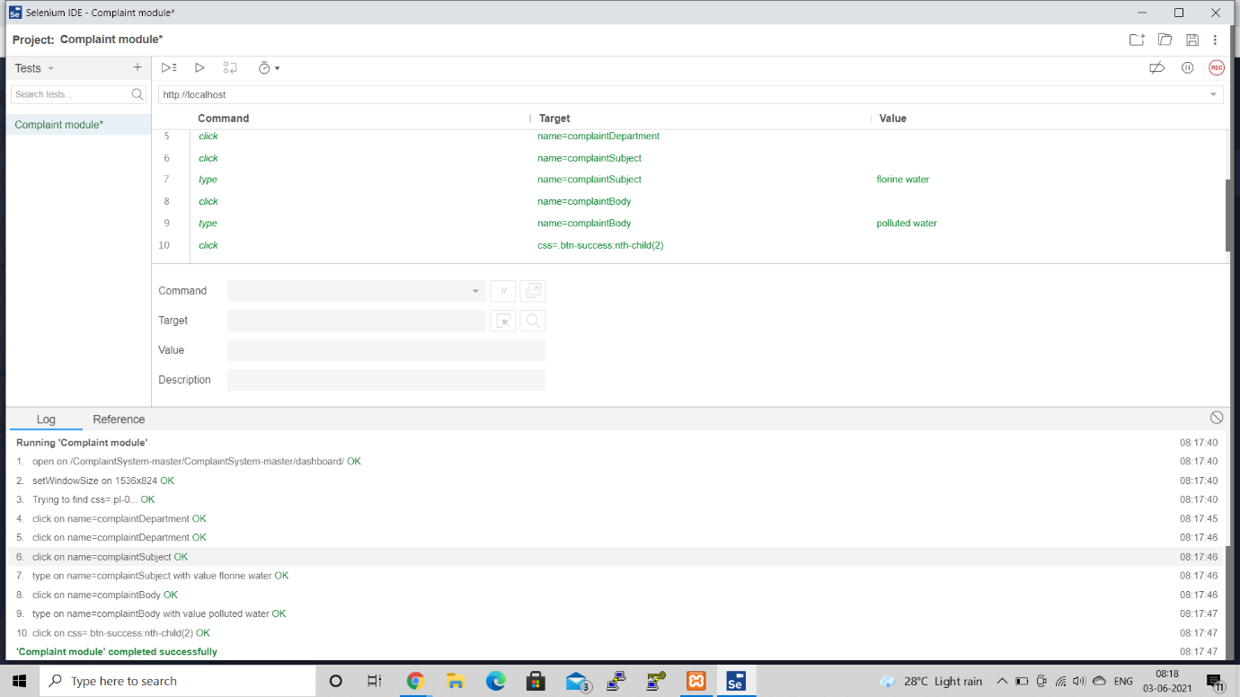
Unit testing using Selenium web driver
Unit testing is type of software testing where individual units or components of a software are tested. The purpose is to validate that each unit of the software code performs as expected.
Unit testing using Selenium web driver screenshots are below:

Slide 170
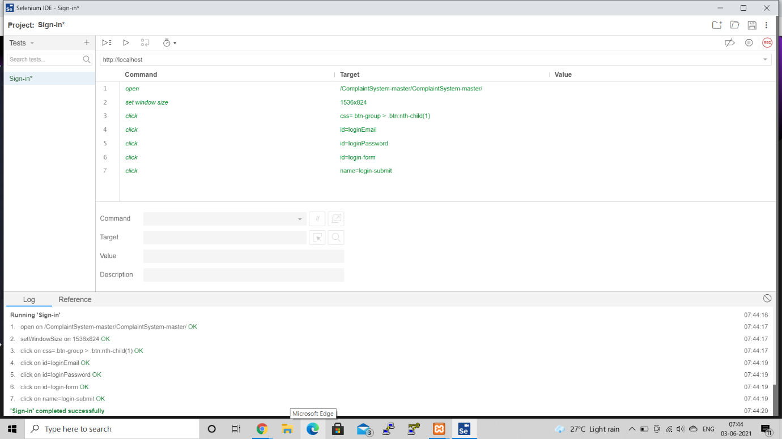


Slide 171

Implementation Output & Screenshot
Figure 1: Importing Data

Slide 172

Figure 2: Quality Parameters

Slide 173

Figure 3: Degradation in

Slide 174

Figure 4: Arsenic Distribution

Slide 175

Figure 5: Fluoride distribution

Slide 176

Figure 6: Iron distribution

Slide 177

Figure 7: Nitrate distribution

Slide 178

Figure 8: Salinity distribution

Slide 179

Figure 9: State wise unique parameter frequency

Slide 180

Figure 10: Quality parameters in Tamil Nadu

Slide 181

Figure 11: Quality parameter in Andhra pradesh

Slide 182

Figure 12: Quality parameter pie distribution

Slide 183

Figure 13: Trends over the years

Slide 184

Figure 14: Testing of python implementation 1

Slide 185

Figure 15: Testing of python implementation 2

Slide 186

Figure16: Home page

Slide 187

Figure17: Sign Up

Slide 188

Figure18: Login

Slide 189

Figure19: Admin Dashboard

Slide 190

Figure20: Admin Complaint section

Slide 191

Figure 21: Admin Profile

Slide 192

Figure 22: Admin announcement section

Slide 193

Figure23: User Dashboard

Slide 194

Figure 24: User complain section

Slide 195

Figure 25: User complain form

Slide 196

Figure 26: WEKA Implementation

Slide 197
Future Work
This project fulfills the partial requirement of government portal.
Constant updation of the quality parameters on a regular basis.
Implementing various other Machine Learning Algorithms for greater efficiency.
Introducing cloud based storage services to prevent the server from crashing and better traffic control.
Impementing python code for segregation of water related problems Soil pollution parameters, Industrial pollution parameters.

Slide 198
Conclusion
The project helps people register complaints, know the status of water in their area. With the help of python programming, we have achieved predictive analysis of water quality in various parts of India.

Slide 199


